Slide 1

Prenos znanja v prakso in podjetništvo
Podjetniške priložnosti in inovacije
Mag. Matej Rus
Notes:
COPY:
Akademija
inovativnega
podjetništaNačrtovanje in izgradnja inovativnih podjetij.
I'm going to discuss building resilient businesses. This is a particularly challenging topic because no company can be invincible. The best approach is to continually reinvent yourself.

Slide 2


Tovarna podjemov
Podjetniški inkubator Univerze v Mariboru
Lokacija:
Ulica škofa Maksimilijana Držečnika 6, 2000 Maribor
Telefon:.
02 229 42 70
Naša spletna stran:
https://tovarnapodjemov.org
Pišite nam:.
info@tovarnapodjemov.org
Lokacija: Ulica škofa Maksimilijana Držečnika 6, 2000 Maribor
Spletna stran: https://tovarnapodjemov.org

Slide 3
podjetništvo in inoviranje
invencija ≠ inovacija
izumitelj ≠ podjetnik
Notes:
"Graditi nekaj iz ničesar je zelo zahtevno.""Ustvarjanje nečesa iz nič je zelo težko.""Začeti nekaj iz nič je izjemno težko."

Slide 4
Podjetniki in inovatorji obladajo umetnost prepoznavanja podjetniških priložnosti. Sposobnost videti nevidno.

Slide 5
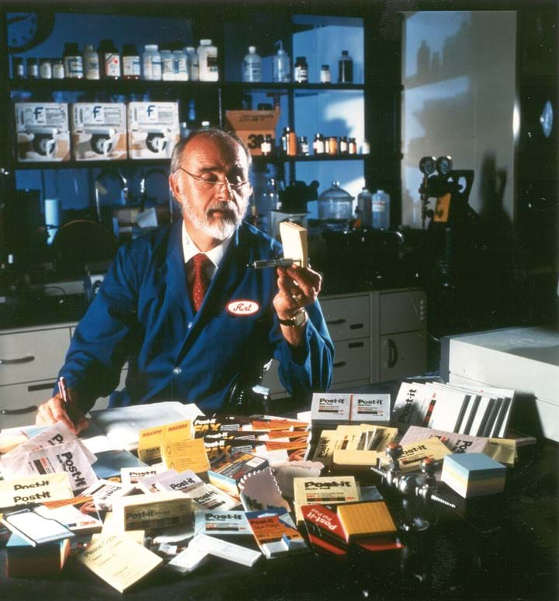
Priložnost
PRIMER: Post-it Notes
“Ko je kemik Spence Silver iz 3M izumil lepilo, ki se ni posušilo zanj ni znal opredeliti koristne uporabe. Ideja je zaživela, ko je njegov kolega Arthur Fry to lepilo uporabil za zaznamke v svoji zborovski knjigi, kar je privedlo do nastanka listkov Post-it.”
SLIDE 5

Slide 6

Priložnost
PRIMER: Viagra
“Direktor družbe Pfizer, William Steere, je odkritje Viagre označil za 'srečno naključje'. Sprva je bila učinkovina namenjena zdravljenju angine, njena učinkovitost za potenco pa se je pojavila kot presenetljiv stranski učinek.
SLIDE 6

Slide 7
Podjetniki so posamezniki, ki pravočasno in gibko identificirajo priložnosti, zberejo potrebne vire, izpelje praktični akcijski načrt in požanjejo nagrado.

Slide 8
Tovarna podjemov:
Zgodovina in poslanstvo

Slide 9
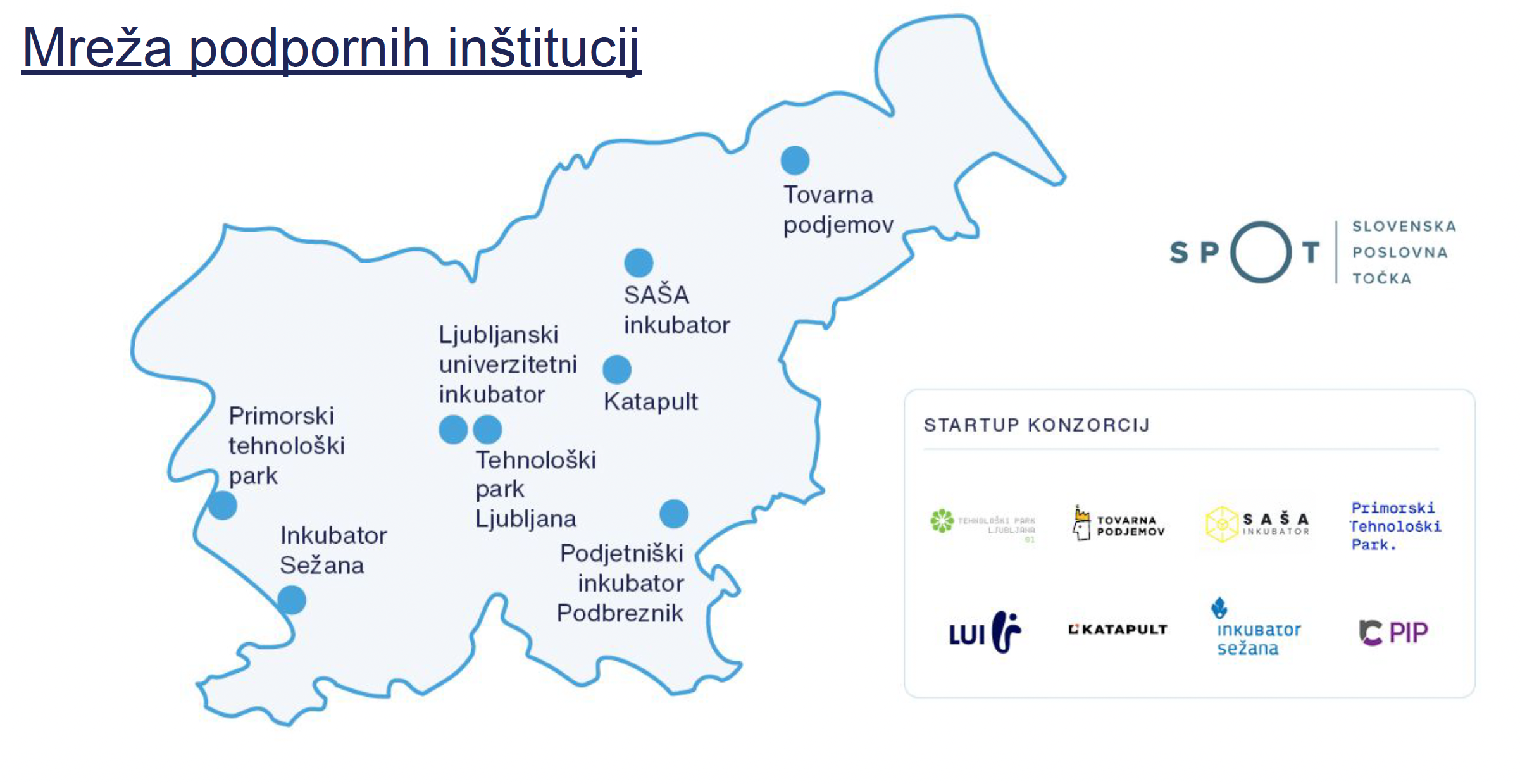
OD LETA 2001
Tovarna podjemov člen startup podpornega okolja

Slide 10
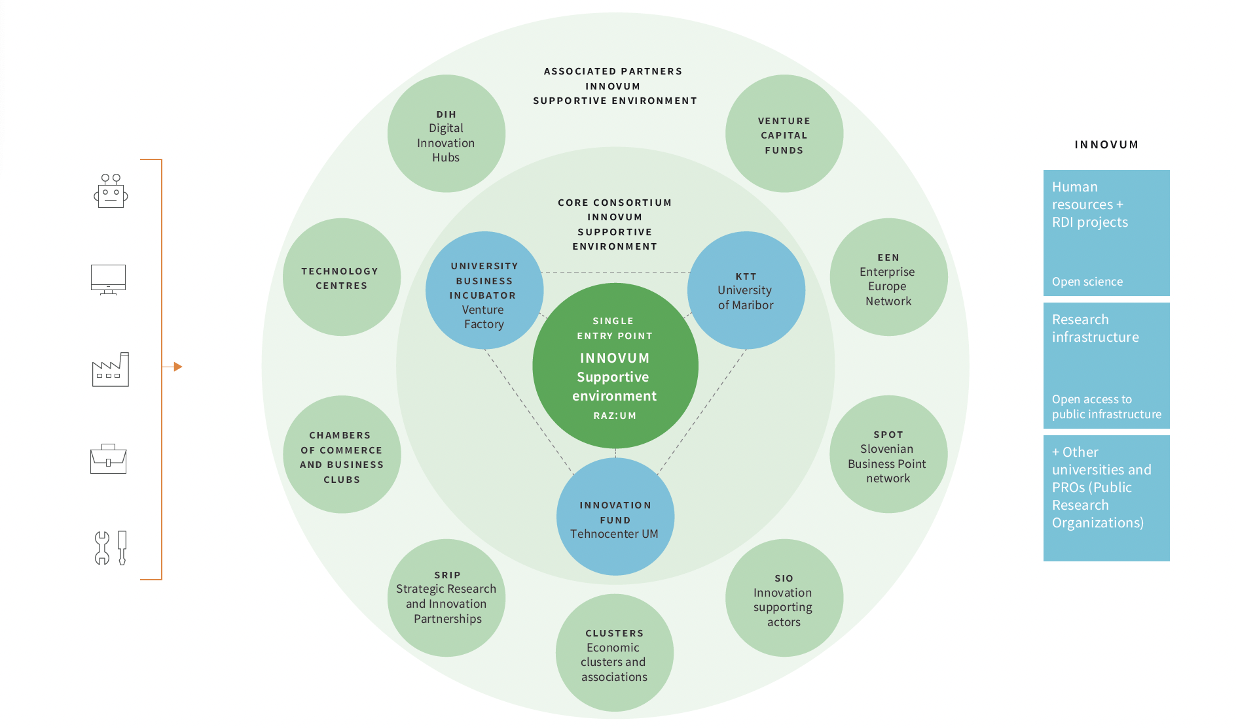
Tovarna podjemov
Jederni partner inovacijskega ekosistema
Univerze v Mariboru - INNOVUM

Slide 11
startupov v okviru programov
Tovarne podjemov
ŠTEVILO PODPRTIH PODJETNIŠKIH POBUD
+100
Notes:
Če znaš zračunat koliko virov!!!!

Slide 12
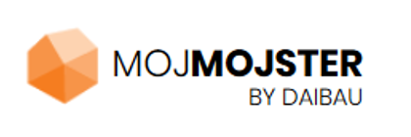


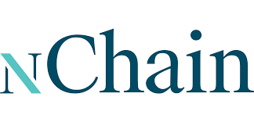



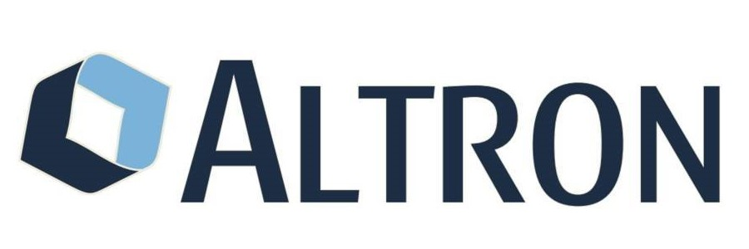




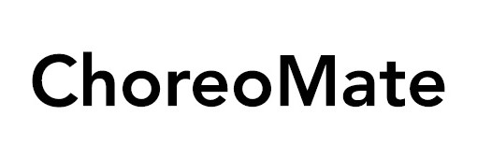
























Izbrana podjetja
Legenda (tip financiranja):
P2
SK50
VC

Slide 13
+7,5 MIO EUR zbranih virov startup financiranja
METRIKA, KI NAJVEČ ŠTEJE
Notes:
Če znaš zračunat koliko virov!!!!

Slide 14
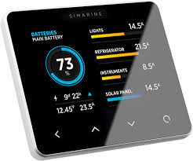
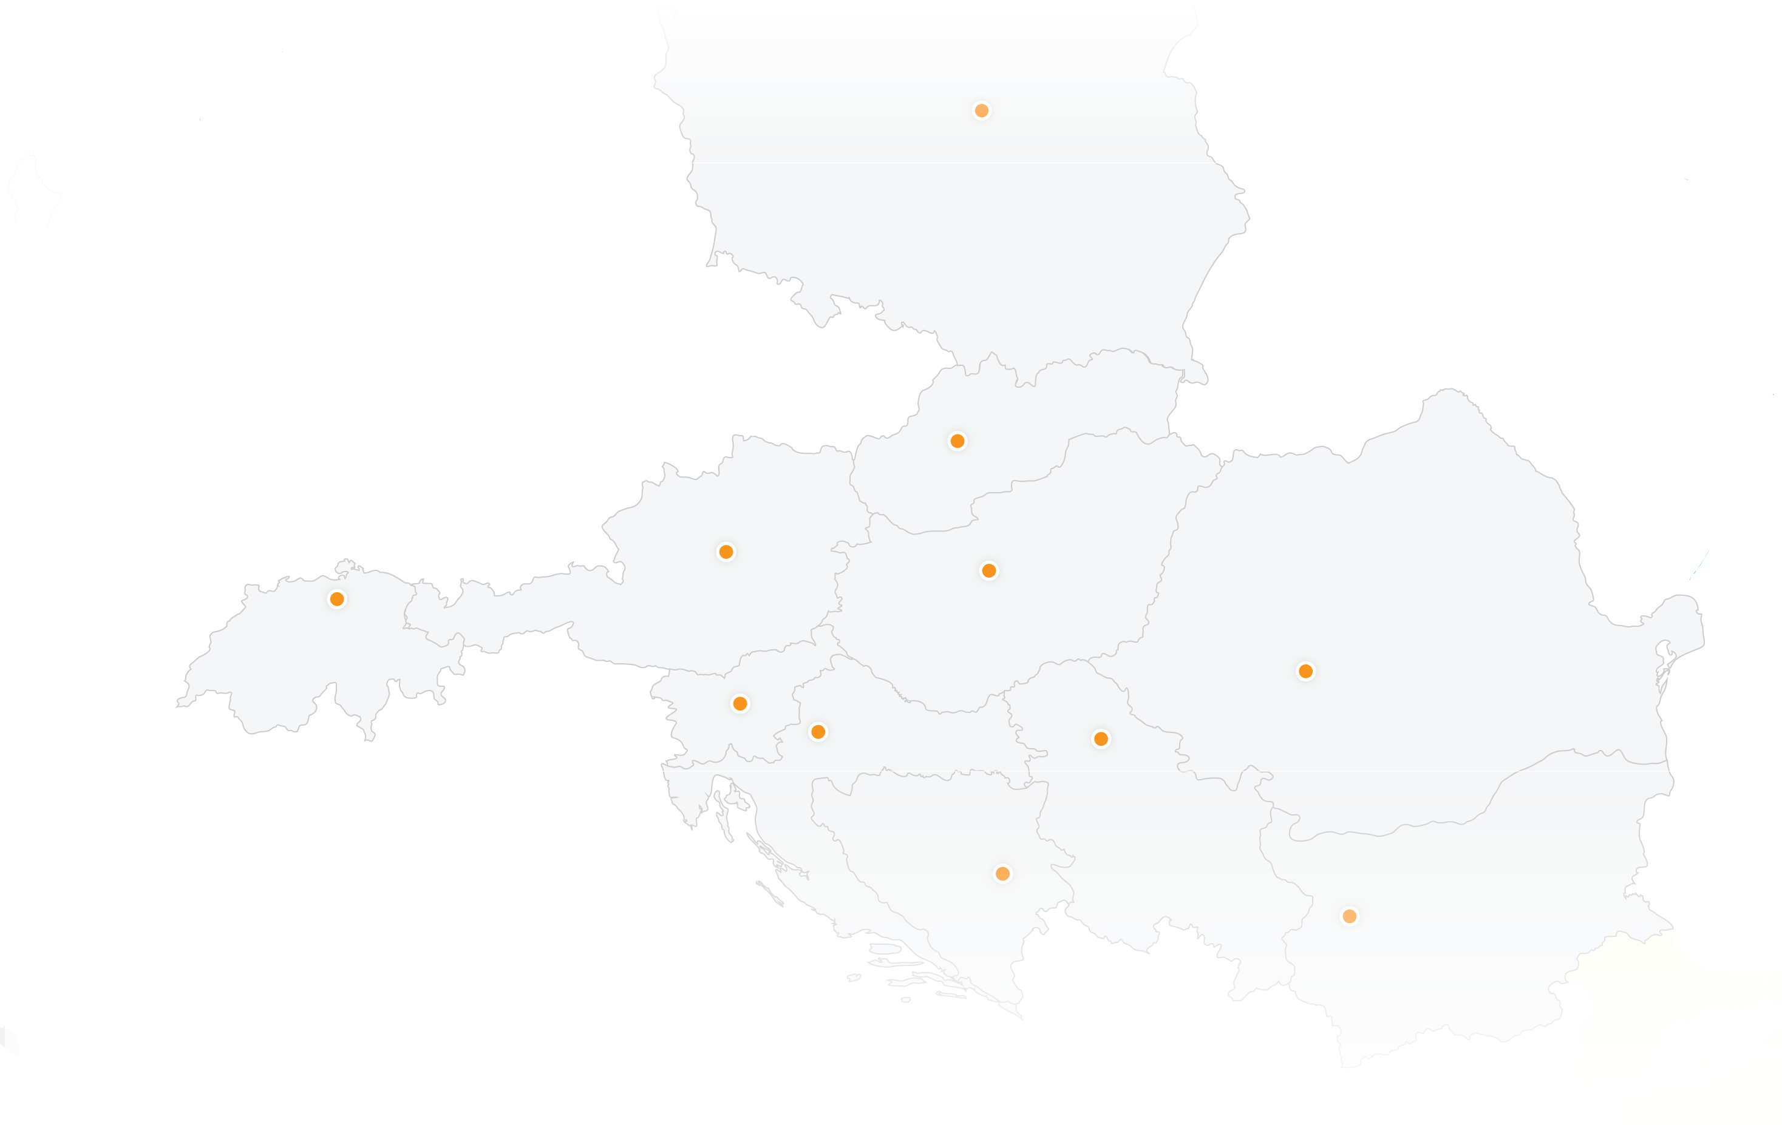
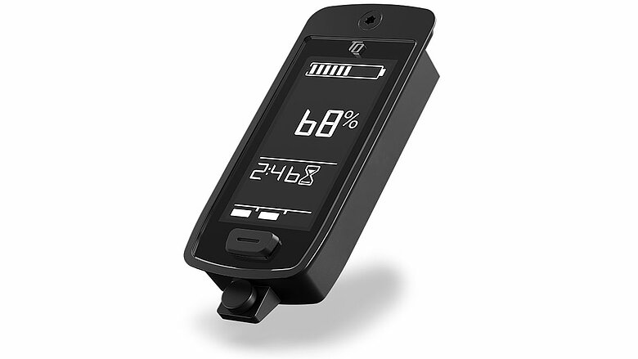



Povprečna letna rast prihodkov v zadnjih treh letih: 78,40 %
Globalna rast v sodelovanju s korporacijo Henkel
Povezava do investitorjev Vito ONE in South Central Ventures, Henkel
Vloga Tovarne podjemov pri rasti
P2
SK50
VC
P2
SK75
VC
Povprečna letna rast prihodkov v
zadnjih treh letih: 54,50 %
Multiplikator v skupnosti
Povezava do investitorja
TQ Group, ki je tudi
Partner INFI7

Slide 15
Graditi nekaj iz nič je zelo zahtevno.
Notes:
"Graditi nekaj iz ničesar je zelo zahtevno.""Ustvarjanje nečesa iz nič je zelo težko.""Začeti nekaj iz nič je izjemno težko."

Slide 16

New Venture Building
Ideas are nice, but effective execution is much more important
5%
The share of success coming from the idea itself.
The share of success coming from proper execution.
95%
Notes:
What this experience taught me is that ideas are nice but effective execution is more important. I would argue that about you know 95% of success comes from proper execution 5% comes from the idea
the idea itself is nice but it doesn't really mean anything until you can bring it to life This is going to probably seem a bit extreme because you're going to say well we've got a fantastic idea and it's very unusual and it's great .
but it's also clear that in itself it's not going to drive value you know just do it is going to to be part of the the process
this kind of focus on execution sits at the heart of our Program.

Slide 17
Izgradnja inovativnih podjetij
Model podjetniškega procesa
JASNA KOMUNIKACIJA
Veliko neznank & negotovost.
Značilnosti trga kapitala & drugi zunanji dejavniki.
Priložnost
Viri
“Pitch” in poslovni načrt.
Legenda:
Entrepreneur
Visok nivo razsežnosti, velikosti in kompleksnosti priložnosti
PODJETNIŠKE METODE IN KREATIVNOST
Vizija in poslanstvo.
VODSTVENE SPOSOBNOSTI
Srednji nivo razsežnosti, velikosti in kompleksnosti priložnosti
Ekipa
Motivacija,
Kompetence & deljena vizija.
Nizek nivo razsežnosti, velikosti in kompleksnosti priložnosti
RAVNOVESJE,
UJEMANJE ELEMENTOV in
TRAJNOSTNI MODEL

Slide 18
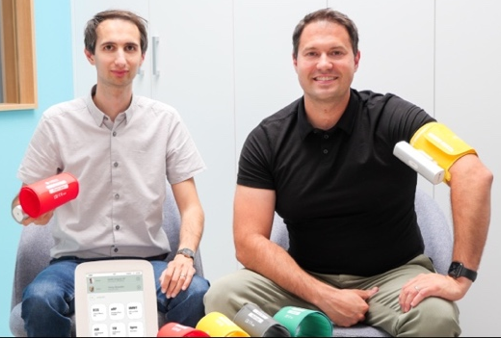
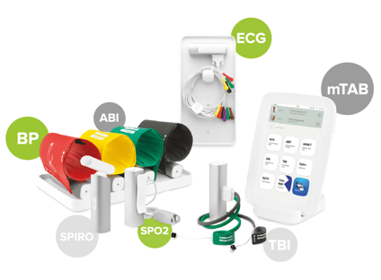
Priložnost
PRIMER: MESI d.o.o.
Ustanovljeno 2010 s strani treh prijateljev: Jakoba Šušteriča (15%), Toma Krivca (13%) in srčnega kirurga Matjaža Špana (2%), ki je zasnoval idejo za prvi izdelek.
Podjetje je pridobilo financiranje od:
Slovenskega podjetniškega sklada (zagonska spodbuda 54k EUR),
poslovnega angela Diane Dimnik (200k EUR investicije za 30% delež), ter
leta 2023 je nemški sklad SHS vložil 18m EUR (45% delež), podjetnik Oliver Heine pa dodatna 2m EUR.
SLIDE 18
Notes:
Mesi d.o.o. is a Slovenian medical technology start-up founded in 2010 by three friends: Jakob Šušterič, Tomo Krivc (at the time both still students at the University of Ljubljana’s Faculty of Electrical Engineering) and Jakob’s cousin Matjaž Špan, a cardiovascular surgeon, who came up with the idea for the company’s first product. This was an ankle-brachial index machine designed to simplify the diagnosis of cardiovascular diseases.
In its first years of operation, as a member of the Ljubljana University Incubator, the company obtained funding from the Slovene Enterprise Fund in the form of a start-up incentive, which was enhanced by a capital investment from business angel Diana Dimnik, a successful entrepreneur. In July 2023 the company obtained a significant investment from German venture capital fund SHS Capital and the investor and entrepreneur Oliver Heine, worth a total of €20 million.
https://necenzurirano.si/clanek/aktualno/diana-dimnik-prodala-podjetje-ki-je-hotelo-drzavi-prodati-ventilatorje-1069294
V podjetju ostajajo njegovi ustanovitelji Jakob Šušterič (15 odstotkov), Tomo Krivc (13 odstotkov) in Matjaž Špan (dva odstotka), sicer srčno-žilni kirurg, pa tudi nemški poslovnež Oliver Heine, ki je lani vstopil v MESI in prevzel vlogo svetovalca.
https://www.crunchbase.com/person/oliver-heine-a818
Danes je njihov glavni produkt mTABLET, ki na enem mestu zbira vse diagnostične meritve in zgodovino pacienta za hitro in učinkovito diagnostiko. "Samo v lanskem letu je naša tehnologija na primarni ravni privedla do odkritja bolezenskih stanj pri več kot 220.000 bolnikih. Več kot 40.000 primerov je bilo digitalno posredovanih specialistom za potrebe drugega mnenje, kar je izboljšalo rezultate ter prihranilo čas in stroške, tako za zdravnike in bolnike," so se pohvalili v podjetju.
S pomočjo zajetne investicije in novih svetovalcev bo lahko MESI razširil prodajno mrežo in portfelj izdelkov in storitev. Med njimi so aplikacije za napovedovanje, ki jih poganja umetna inteligenca. "Verjamemo, da bo naša naložba podjetju omogočila nadaljevanje njegove impresivne poti rasti," je ob tem poudaril Sascha Alilovic, vodilni partner pri skladu SHS. Lani je MESI ustvaril dobrih sedem milijonov evrov prihodkov, kar je 40 odstotkov več kot leta 2021. Zaposluje že več kot 50 ljudi.
Del prihodkov ustvari tudi s slovenskimi javnimi zdravstvenimi zavodi. V zadnjih desetih letih je od njih prejelo že več kot milijon evrov, največ od zdravstvenih domov Piran in Koper. S subvencijami sta mu pomagala tudi ministrstvo za gospodarstvo in javni sklad za podjetništvo.

Slide 19
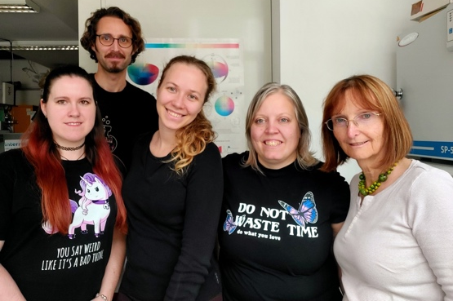
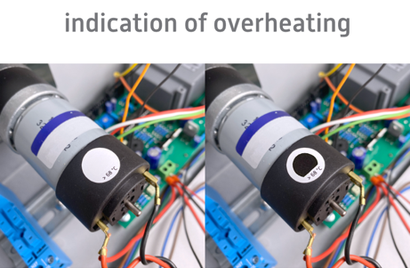
Spin-out zgodba
PRIMER: MyCol
Ustanovljeno leta 2017 kot spin-out Kemijskega inštituta.
Leta 2019 prejelo donacijo SME Instrument Faze 1 v skupni vrednosti 70.000 € za razvoj izdelkov.
Leta 2020 pridobilo donacijo Eureka Eurostars v višini 233.328 € za razvoj projekta.
Leta 2021 pridobilo podporo EU programa Horizon 2020 (EIC Accelerator) v vrednosti 1.540.000 €.
Leta 2024 je prejelo investicijo VC sklada VESNA.
SLIDE 19
Notes:
Ustanovljeno leta 2017 kot izločitev iz Nacionalnega inštituta za kemijo v Ljubljani.
Leta 2019 je prejelo grant SME Instrument Faze 1 v skupni vrednosti 70.000 € za razvoj svojih izdelkov.
Leta 2020 je pridobilo grant Eureka Eurostars v višini 233.328 € za svoj razvojni projekt.
Leta 2021 je pridobilo dodatno podporo v okviru EU programa Horizon 2020 (EIC Accelerator) v skupni vrednosti 1.540.000 €.
Leta 2024 je prejelo investicijo VC sklada VESNA.
MyCol d.o.o.
Founders
Marta Klanjšek Gunde (CEO)
Nadja Železnik and others
Intellectual property
Licensing agreement for core technology
International patent application filed (PCT)
Trade secrets and know-how
Website: www.mycol.si/
Product
With certain products, it is very important to be able to tell whether they have exceeded their critical temperature. This applies, for example, to food in supply chains, where exceeding a specific critical temperature can result in permanent spoilage. Temperature control is also important in manufacturing activities, where correct heating affects the quality of products and protection against excessive energy consumption. Examples of this are found in the rubber industry (after vulcanisation), the automotive industry (thermal relaxation after welding plastic components) and the metal industry. Last but not least, it is important to monitor the overheating of specific components in electronic devices, where overheating can lead to breakdowns and damage to systems.
MyCol d.o.o. has developed a system for the visual control and registration of temperature changes in the form of smart stickers or printed labels. Applied to products, these enable the identification and visual representation of situations in which the temperature of the product exceeds a specific critical limit. They are based on the use of an innovative ink that changes colour when a specific temperature threshold is exceeded and retains the new colour even after the temperature drops. The changes of colour are visible to the naked eye and can also be detected by camera, thus allowing the possibility of automatic control.
Through its products on the market, the company aims to significantly reduce the impact of industrial processes on the environment and encourage a more sustainable world. It has also obtained independent proof that its stickers can be recycled together with packaging. With the help of a voucher from the Slovene Enterprise Fund, it has successfully completed a life-cycle assessment (LCA).
MyCol d.o.o. was founded in 2017 by a team of highly qualified women. The company is registered in Slovenia. In 2019 it was awarded an SME Instrument Phase 1 grant totalling €70,000 to develop its products. In 2020 it obtained a Eureka Eurostars grant of €233,328 for its development project, while in 2021 it obtained additional support under the EU’s research and innovation programme Horizon 2020 (EIC Accelerator) in a total amount of €1,540,000.
Intellectual property
MyCol’s solution originates from research into smart chromogenic materials carried out at the National Institute of Chemistry in Ljubljana, one of the world’s leading institutions in this field. The company was founded as a spin-out of the Institute, with which it has signed the appropriate licensing agreement for the use of core know-how.
The company is well aware of the importance of intellectual property and manages it diligently. Intellectual property is not only important for obtaining investment, it is the key to the successful sale of solutions of this type. Customers (manufacturing companies) expect products to have patents, proving that they genuinely represent a unique technology. Patent protection also serves as evidence of the reliability of the solution.
An international PCT patent application filed with the Slovenian Intellectual Property Office (URSIL) in October 2022 covered protection of the formulation and manner of use of new inks. In addition to the patent application, the company is also considering trade mark registration and is therefore planning to apply for financial support from the SME Fund implemented by the European Union Intellectual Property Office (EUIPO). The company is also actively protecting its extensive trade secrets and know-how by signing non-disclosure agreements or inserting non-disclosure clauses into its employment contracts.
As company co-founder and CEO Dr Marta Klanjšek Gunde explains: “At MyCol we are extremely aware of the importance of protecting intellectual property, since it is the key to our success in the market. We are also aware of the need for further patent protection of additional technological solutions and the expansion of the protection of our products in the future. Unfortunately we are currently facing the challenge of a lack of funds – although more funding will become available once the company has managed to secure more investment or begins generating higher revenues in the market. Some help in this regard has already come in the shape of a voucher from the Slovene Enterprise Fund. In the future we are also counting on a grant from the SME Fund implemented by the EUIPO.”
Awards and accolades
In 2021 top researcher Dr Marta Klanjšek Gunde, co-founder and CEO of MyCol d.o.o., received the WIPO Medal for Inventors, a prestigious accolade that is awarded to researchers at public research organisations in Slovenia who contribute, through patent-protected inventions, to the development and prosperity of the Slovenian economy and Slovenian society. Innovation intelligence company StartUs Insights has identified MyCol’s solution as one of the world’s top five smart label solutions impacting food businesses because it enables control of the storage and transport of temperature-sensitive products and in this way helps reduce waste caused by temperature control errors.

Slide 20
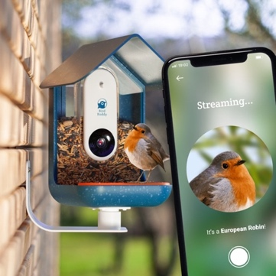
Bootstrapping
PRIMER: Bird Buddy Kickstarter success
“Podjetje je na platformi Kickstarter zbralo dobre 4 mio EUR. Skupaj več kot za 30 mio EUR tveganega kapitala. Trenutno so že preko 100 mio EUR prihodkov”
SLIDE 20
Notes:
Kickstarterju uspešno zbrali skupaj 4,19 milijona EUR, s čimer so postali slovenski rekorder na tej platformi za množično financiranje. Poleg so pridobil še dodantih 8,5 milijona USD semenskega kapitala zasebnih investitorjev, kar priča o njihovem izjemnem potencialu za rast in uspeh.

Slide 21
Izgradnja inovativnih podjetij
Značilnosti pravih poslovnih priložnosti
Ustvarjajo znatno vrednost za uporabnike.
Naslavljajo resničen tržni problem in imajo določeno konkurenčno prednost.
Uporabniki čutijo veliko nujnost in so zato za rešitev pripravljeni plačati.
Imajo močan potencial za rast prodaje in doseganje visokih marž.
Ustanovitelji in vodstvena ekipa imajo kolektivno izkušnje na domenskih področjih, ki se ujemajo s priložnostjo.

Slide 22


Pot od ideje do uspešnega podjetja
Ne naredite napake, da bi izvajali poslovne ideje brez dokazov: temeljito preizkusite svoje ideje, ne glede na to, kako odlične se morda zdijo v teoriji.
Ideja
Iskanje & testiranje ujemanja s trgom
Izvajanje in grajenje posla
Podjetje
Notes:
COPY:
Traditionally, we used to rely on writing business plans to turn ideas into real businesses.
However, we now understand that this process is often messy and chaotic.
It's really about finding value propositions that resonate with customers and developing business models that can scale profitably.
Too many entrepreneurs and innovators execute ideas prematurely because:
they look great in presentations,
make excellent sense in the spreadsheet,
and look irresistible in the business plan.
If we get it right on paper still doesn't mean it's gonna work!

Slide 23

Izgradnja inovativnih podjetij
Miti in realnost glede podjetnikov
Vsakdo lahko ustanovi podjetje.
Podjetniki so rojeni, ne narejeni.
Če ustanoviš podjetje in propadeš, ne boš nikoli več pridobil financiranja.
Podjetniki so hazarderji.
Denar je najpomembnejša sestavina za zagon podjetja.
Začeti je najlažji del; pravi izziv je preživeti, rasti in ustvariti dobičkonosno podjetje.
Podjetniki so morda rojeni s kreativnostjo in energijo, vendar te lastnosti potrebujejo razvoj.
Podjetniki, ki jim ne uspe, lahko pridobijo podporo vlagateljev zaradi učenja iz svojih napak.
Uspešni podjetniki ciljno znižujejo tveganja in se izogibajo tveganjem.
Bolj ključni so prava priložnost, ekipa in časovna usklajenost.

Slide 24

Statistika portfelja Tovarne podjemov
STRUKTURA PORTFELJA: 81
Startup ekipa: 10
Startup podjetja: 66
Scale-up podjetja: 5
PRIHODKI & ŠTEVILO ZAPOSLENIH PORTFELJA
Celoten portfelj Samo sedež v Mariboru*
Skupni prihodki v 2021: 48,28 MIO EUR 24 MIO EUR
Skupno število zaposlenih v 2021: 360 207
OPOMBA: v the vrednosti ni vseh prihodkov podjetij v tujini, že prevzetih startupov (nChain – bivši Equalize, ki v MB zaposluje 80 ljudi, Povio, ki ima sedež v SF v MB zaposluje 50 ljudi).
Notes:
Urban preveri za Nchain in Povio za število ljudi

Slide 25

Startup program
3 mesečni program
“Postavi temelje inovativnega podjetja”
V zadnjih treh letih najbolj ponosni na …
Scaleup mentorski in svetovalni program
Program mentorstva in svetovanja, za povečanje prodaje, novih investicij in strukturiranju organizacije za rast

Slide 26


Slide 27
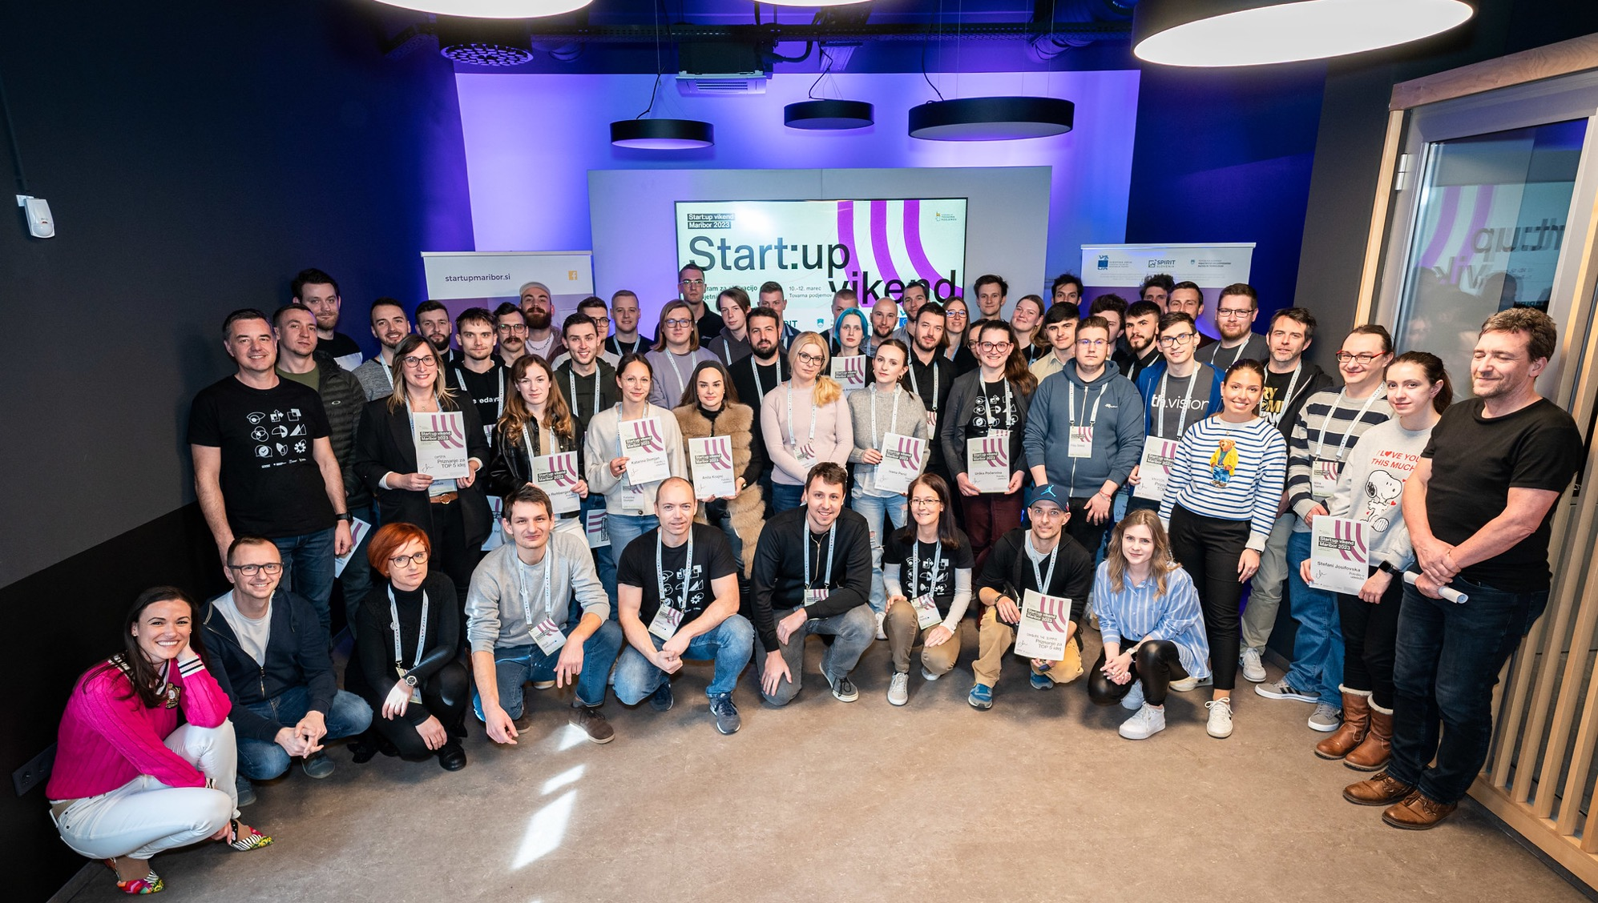

Slide 28

2., 9. in 15. oktobra 2025, Perfect Pitch
16. oktobra 2025, DEMO DAN
Notes:
1. srečanje — četrtek, 2. oktober, 9:00–16:00
Domača naloga: osnutek decka + uskladitev 1:1 z mentorjem do naslednjega srečanja.
2. srečanje — četrtek, 9. oktober, 9:00–16:00
Domača naloga: predaja materialov za profesionalno oblikovanje decka + zadnji popravki z mentorjem.
3. srečanje — sreda, 15. oktober, 9:00–17:00
Generalka + Strategija pristopa do investitorjev
Demo dan — četrtek, 16. oktober
Možnost nastopa na Start:up Slovenija Demo dnevu 2025 pred aktivnimi slovenskimi investitorji.

Slide 29
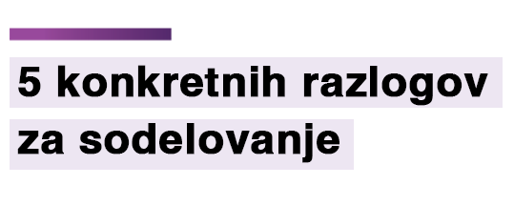
Vsebinsko izpiljen in oblikovan 5 min pitch za investitorje.
Trening javnega nastopa z izdelanim pitchem.
Profesionalno oblikovanje Pitch Decka
Strategija pristopa do investitorjev
Možnost predstavitve pred investitorji na Demo Dnevu

Slide 30


Močan partner mariborskega ekosistema
Primer podjetja SKYLABS
Podjetje izšlo iz FERI Univerze v Mariboru s katerim tesno sodeluje. Je magnet za najboljše strokovnjake iz širše regije ter odličen promotor univerze.
Naš PARTER na Cassini Hackathonu 2024
Notes:
Zamenjaj sliko ozadja z eno iz njihove spletne strani (https://www.skylabs.si)

Slide 31
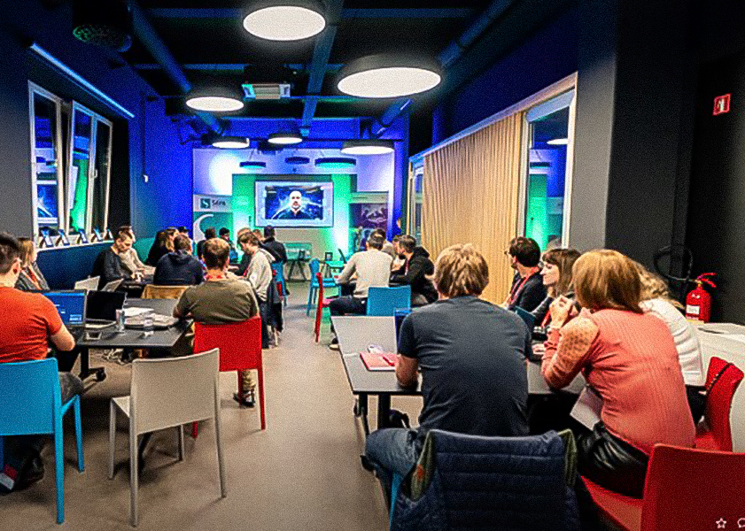


Infrastruktura
Sodobno okolje za učenje, inoviranje in poslovanje
Tovarna podjemov deluje v 500 m² velikih sodobnih prostorih v centru mesta Maribor, kjer izvajamo podjetniške programe in nudimo pisarne za poslovanje zagonskih podjetij.
Lokacija: Ulica škofa Maksimilijana Držečnika 6, 2000 Maribor
Spletna stran: https://tovarnapodjemov.org
Notes:
Slika: https://www.flickr.com/photos/startupslovenia/albums/72177720303514307/page2

Slide 32
+28k
POSTANITE DEL NAŠE SKUPNOSTI
Sledilcev na socialnih omrežjih

Slide 33
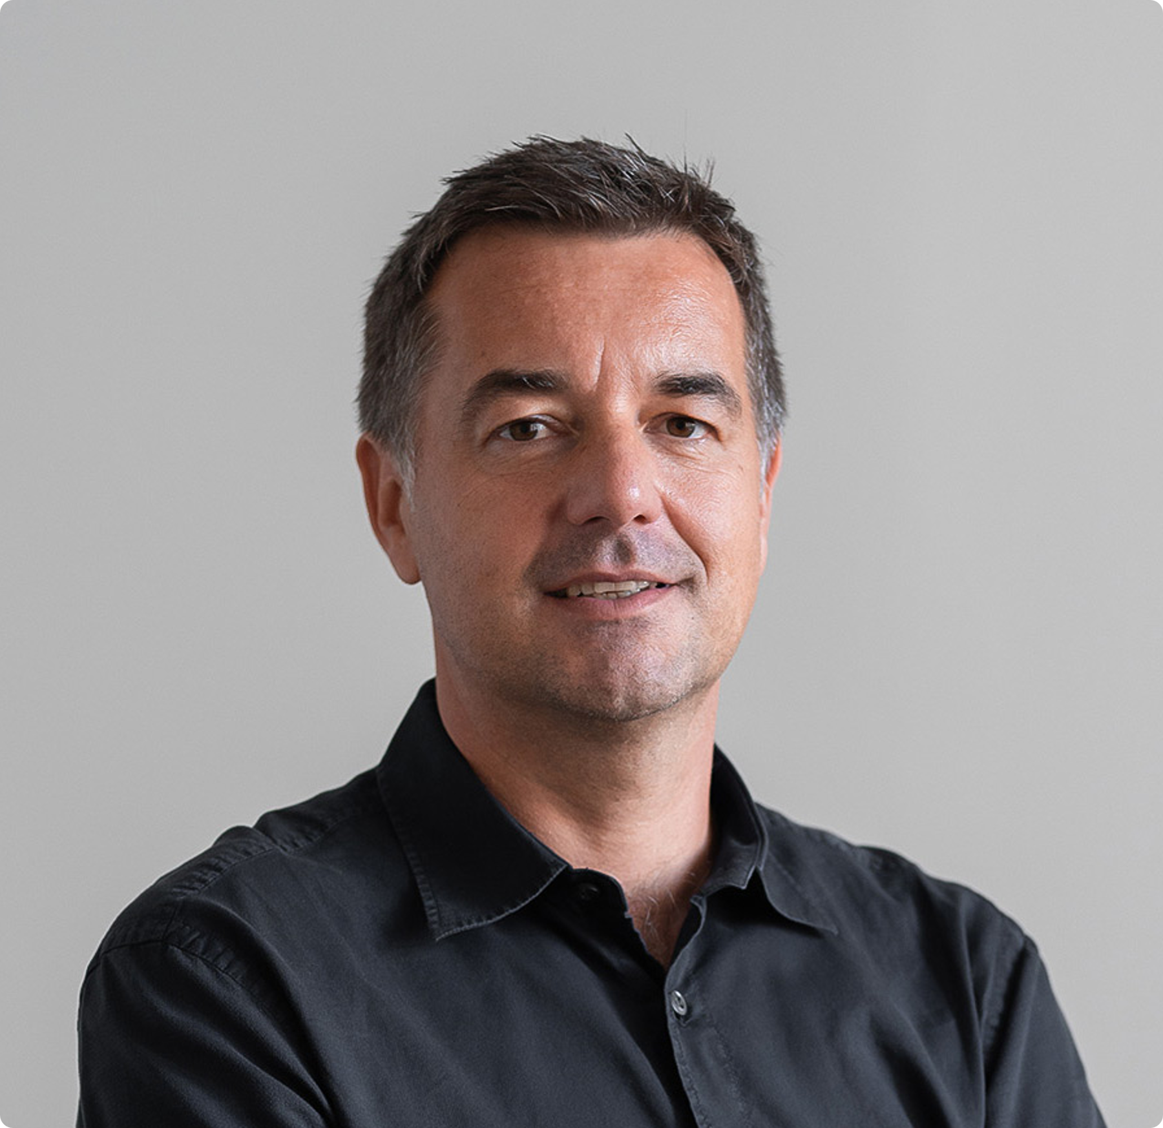
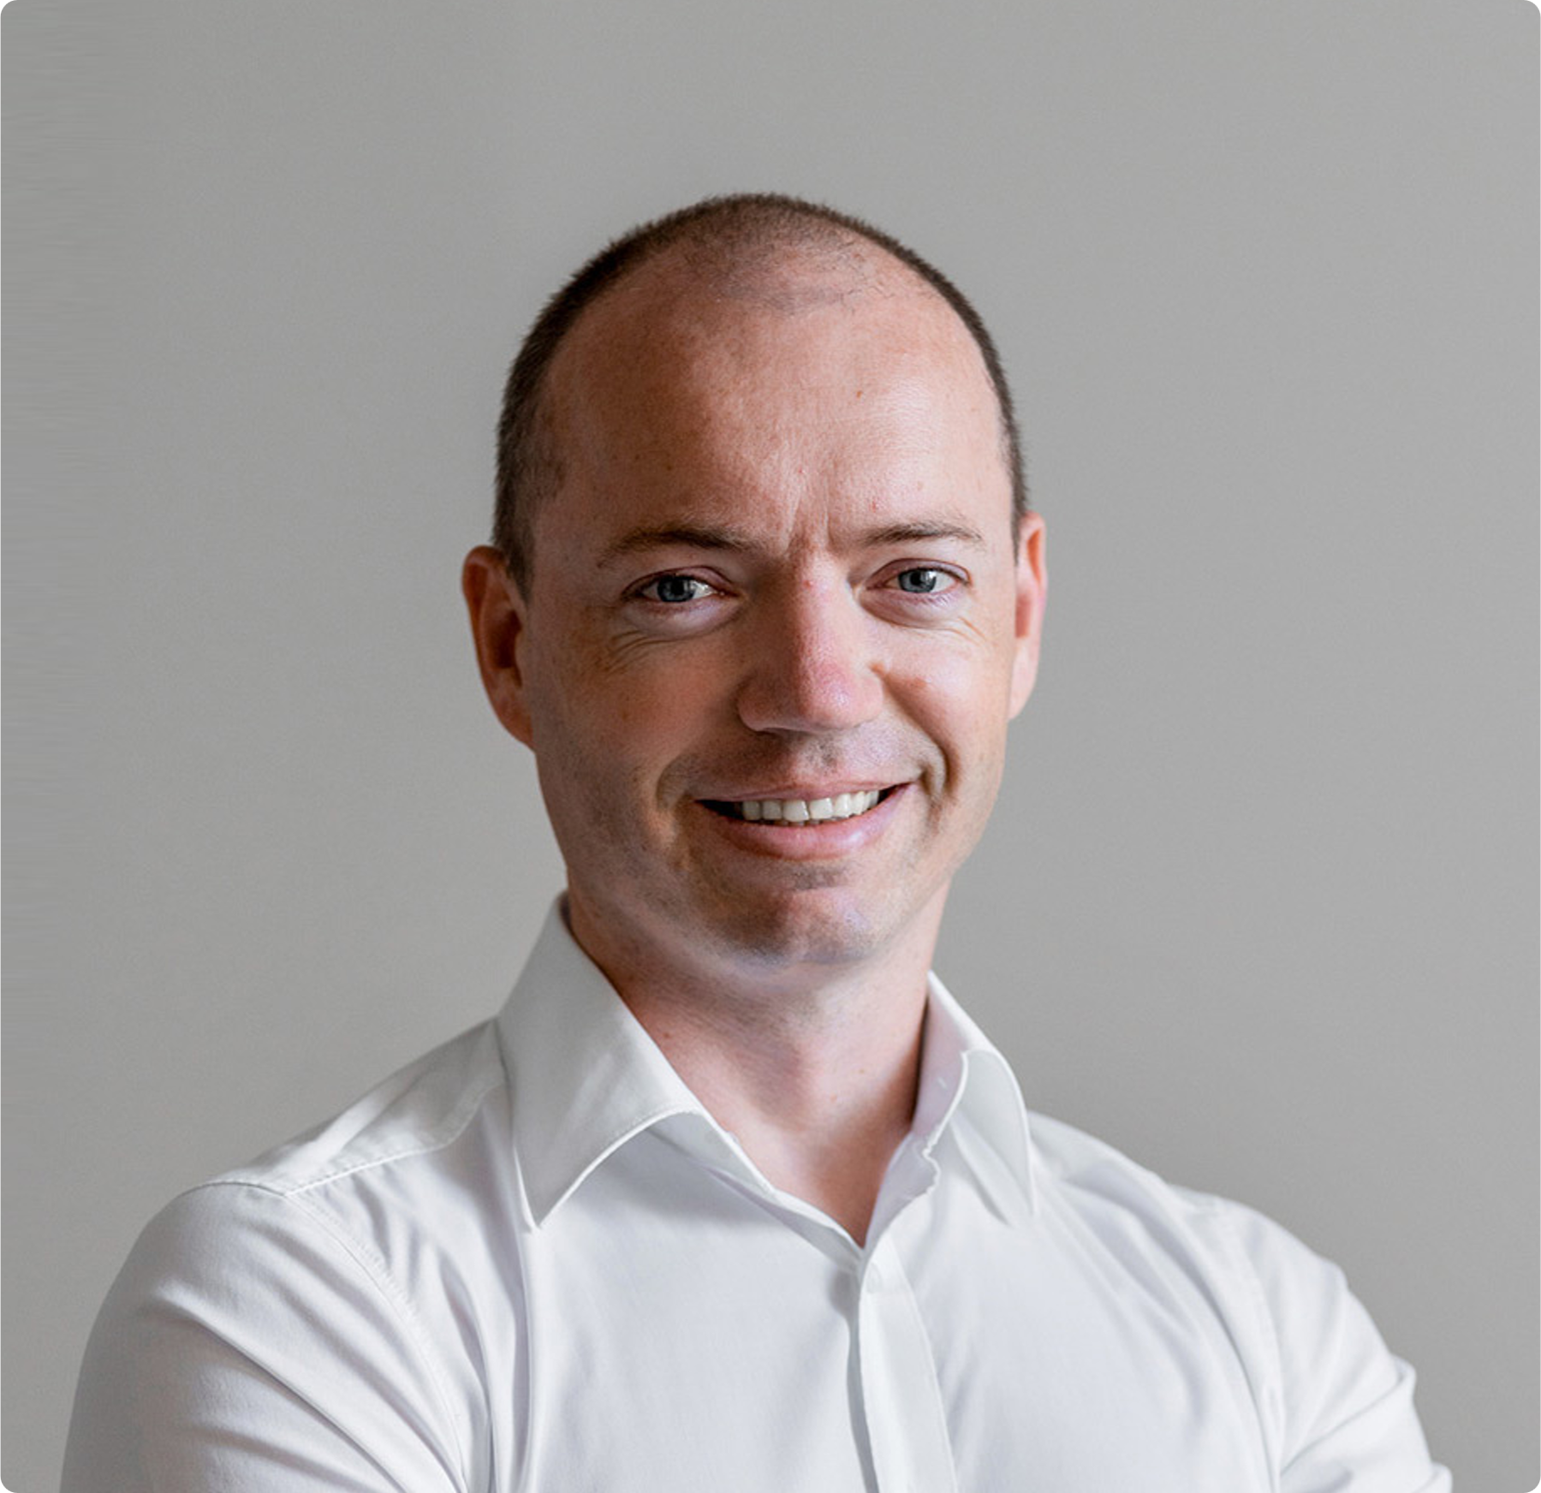
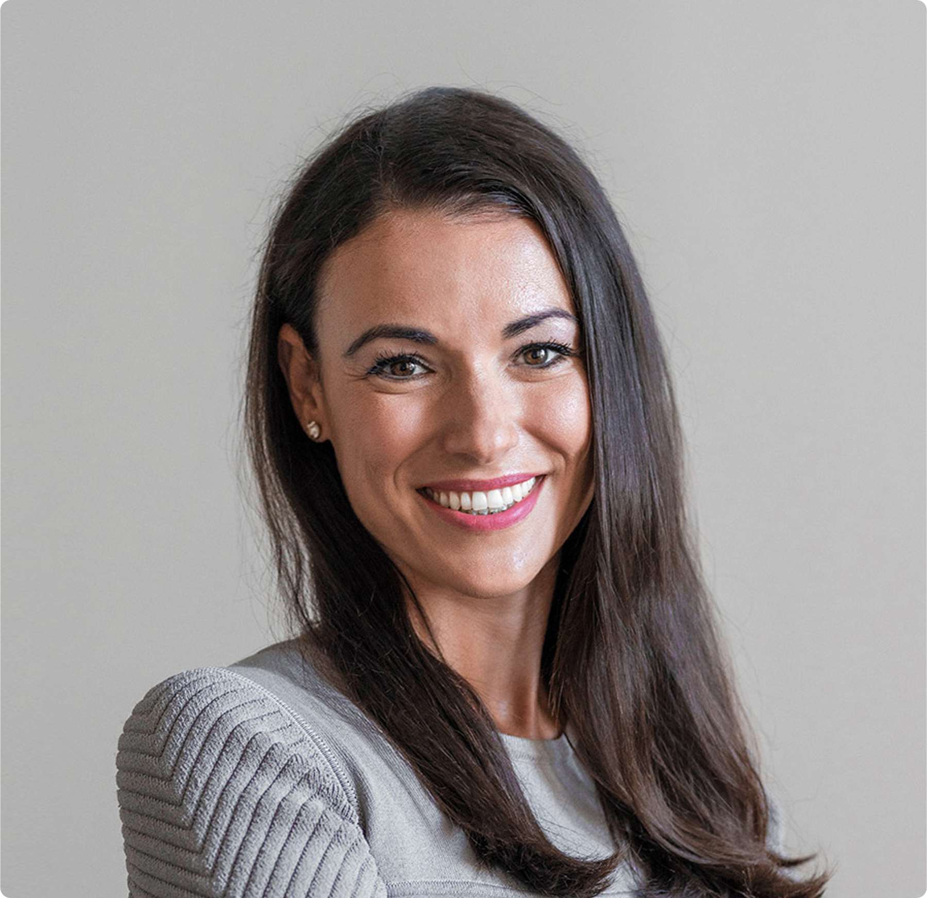
Jedrna ekipa
Tovarna podjemov
Matej Rus
Founder & CEO
Urban Lapajne
Program Manager
Nataša Rus
COO
Matej Rus je leta 2001 so-ustanovil zavod Tovarno podjemov, kot neprofitni inštitut za podporo razvoja podjetništva. Od ustanovitve je njegov direktor.
Urban Lapajne je strokovnjak za oblikovanje startup programov, svetovalec in povezovalec deležnikov ekosistema z več kot 20 leti izkušenj.
Nataša Rus je izkušena vodja programov in marketinška svetovalka z več kot 20 leti izkušenj.

Slide 34

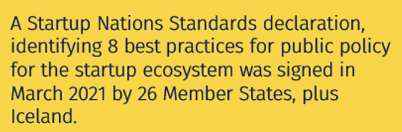
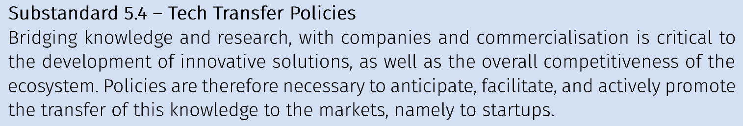

Slide 35


Slide 36
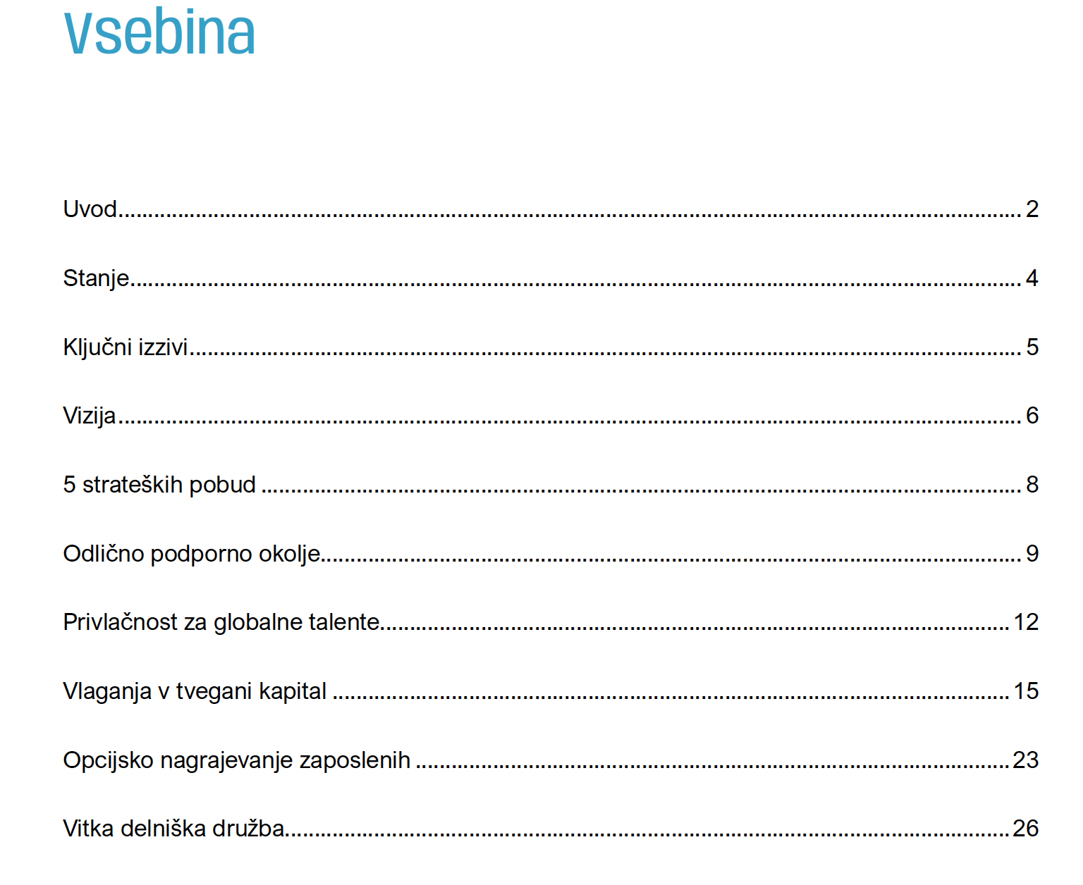

Slide 37
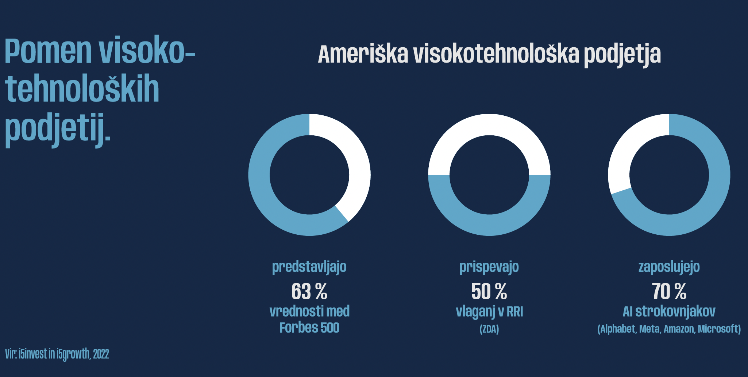

Slide 38
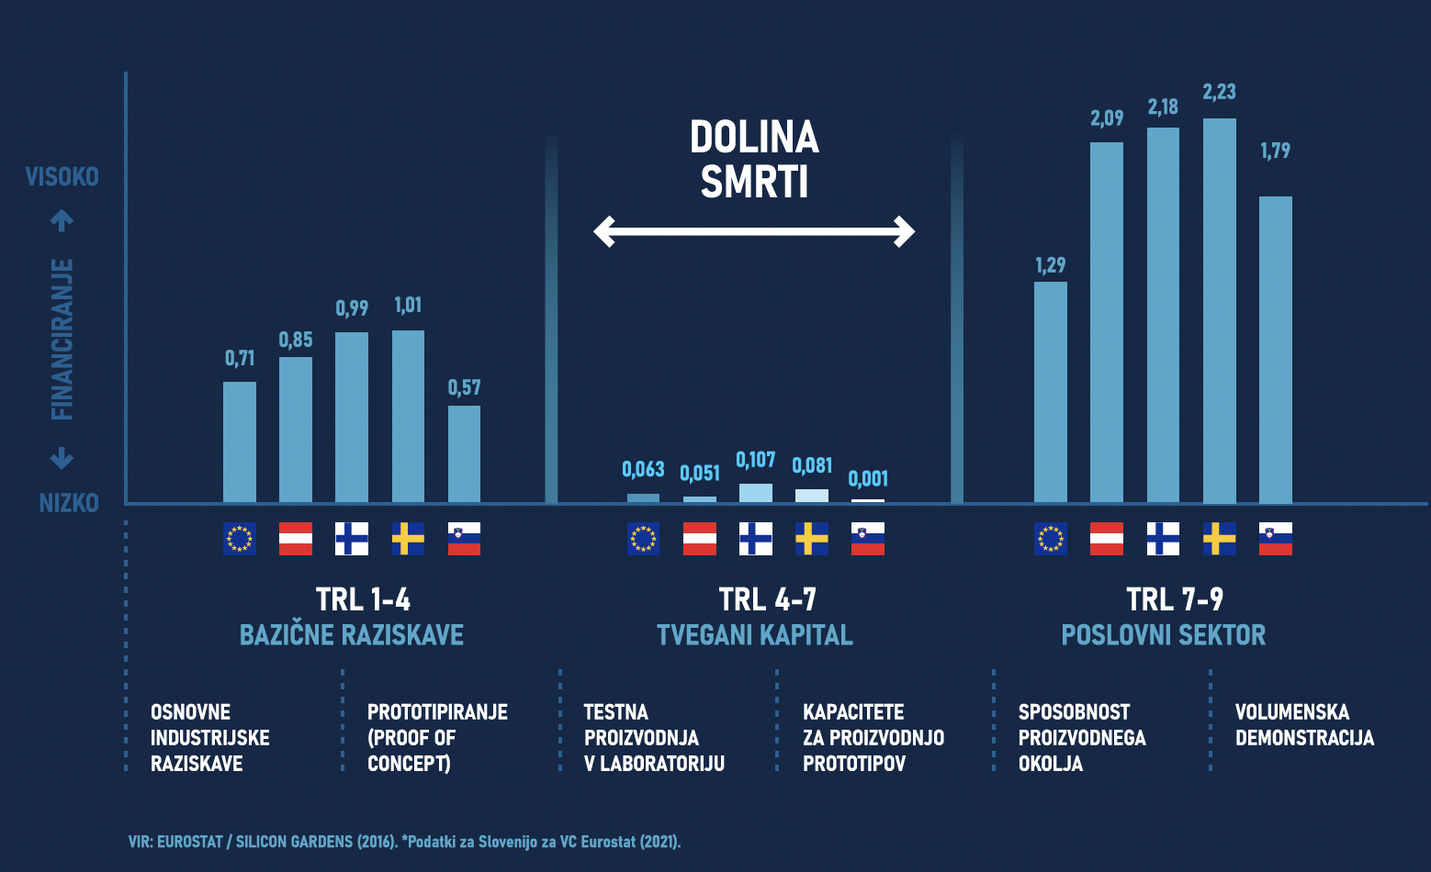

Slide 39
Tovarna podjemov
Podjetniški inkubator Univerze v Mariboru
Lokacija:
Ulica škofa Maksimilijana Držečnika 6, 2000 Maribor
Telefon:.
02 229 42 70
Naša spletna stran:
https://tovarnapodjemov.org
Pišite nam:.
info@tovarnapodjemov.org

Slide 40
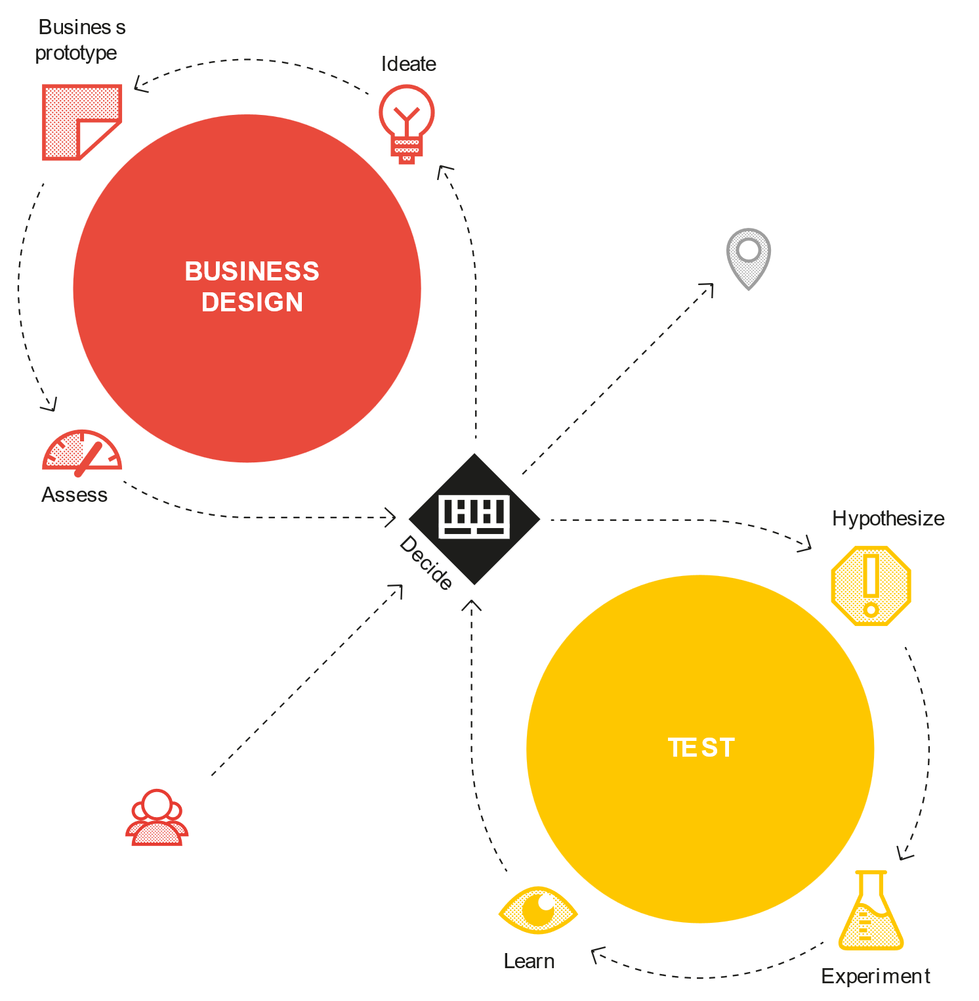
The iterative process
Design as if you were right
Test as if you were wrong
Notes:
WHAT IS THE PROCESS CONCRETELY?
The process itself has two iterations with six steps.
it has two areas
One is BUSINESS DESIGN. You look at your business model and value proposition.
And the other one is TESTING it.
These are two different fundamental things and you go back and forth between these loops all the time. So rather than making a business plan (the business plan is the enemy of innovation) you want to constantly test and adapt your ideas. So ideas are just the starting point.
How does this process look like.
You ideate around which value proposition or value propositions are you gonna create for customers and in which business model are you gonna embed them.
You make a conceptual prototype (not a physical one) with the business model canvas and the value proposition canvas. It means creating a very clear kind of prototype of how that could look on paper! You spend maybe half a day or a day on that maximum.
Immediately you ask what are the hypothesis underlying this idea that we need to test with experiments in order to learn and adapt the idea.
Incredibly important that we go through this double loop again and again and again. And when you go through this double loop you will de-risk the ideas. You actually not just design a business model and value proposition but constantly test and adapt it. As an coach we can help the teams go through this double loop.
Your idea inside your head is great! but it's like this perfect little thing that no one else can touch and it doesn't get tested against reality!
STEPS:
Ideating: figuring out what the value propositions and business models could be
Business prototyping: mapping them out with the business model canvas and value proposition canvas. we're prototyping out canvases to understand visually from a storytelling point of view what does that look like
Assessing: if these make any sense which is more like a design assessment. Some kind of high level assessment: what are the strengths and weaknesses, what's the environment look like) and then decide if this is good enough. That should be done maybe after an hour, maximum half a day.
if it's good enough you accept that. Probably it's wrong but it's a great point to start and you go and test.
Hypothesis: before you test you need to ask what are the key assumptions the key hypothesis underpinning your idea that need to be true for this idea to work!. you figure out the most important ones those are the ones you're going to test.
Experimenting: you're going to run experiments and you need to run many experiments. For our testing we design experiments that address our risk so the things that are most important where we have the least amount of evidence.The experiments are again at the beginning rarely to build something. Big part of our coaching to you is whipping the teams in shape and get them to go through 10, 20 experiments and experiment.
Learning: from the experiments you obviously learn and from the learning you make decisions. You either adapt the idea so you go back to BUSINESS DESIGN loop or you continue with experimentation to get more evidence and stronger evidence.
You go through this LOOP time and time and time and time again until you start to find something that might be a real business that you could scale. what usually kills every new business idea is people try to scale too quickly .
We like to say: DESIGN AS IF YOU WERE RIGHT but TEST AS IF YOU WERE WRONG
OBSERVATION IN PRACTICE:
Some people are either doing a lot of business design a little testing or a lot of testing and a little business design.
Some people don't necessarily go through a process.
they interview five customers
they build it and
then they try to scale.
We also see is actually data paralysis where people test all the time and they learn all the time but they actually don't make decisions to improve the business model and kind of move to you know closer from idea to real business.
Incredibly important that we go through this double loop. And when you go through this double loop you will de-risk the ideas.

Slide 41
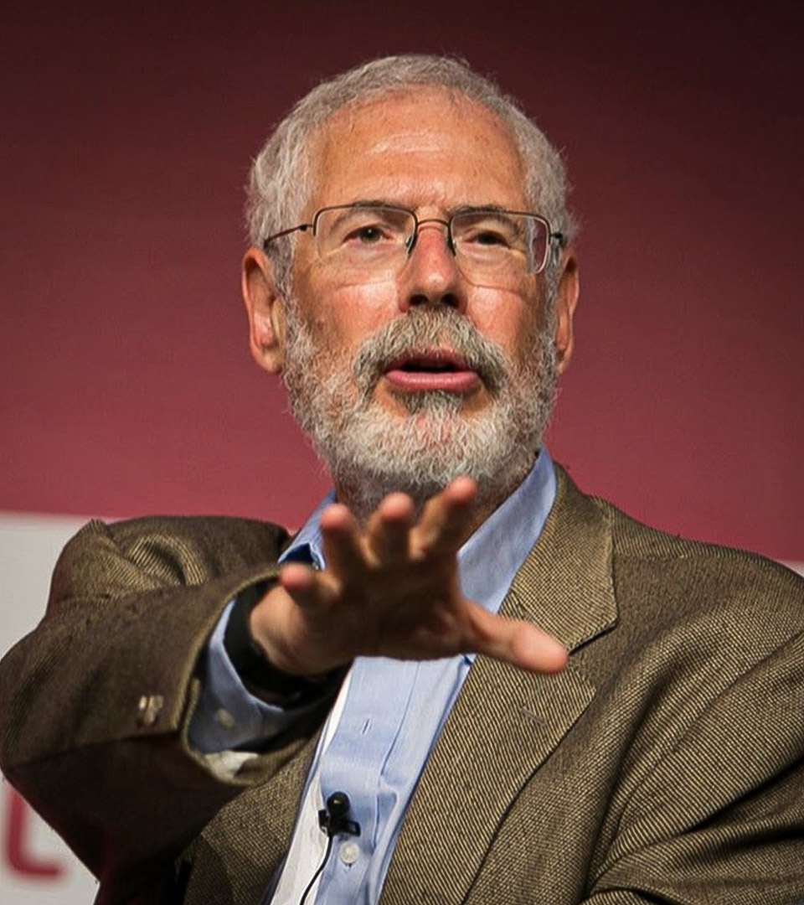
“There's a fine line between vision and hallucination“
Steve Blank,
Entrepreneur, educator and author
Notes:
COPY:
Steve Blank who invented the whole Lean Startup movement with customer development likes to say:
»There's a fine line between vision and hallucination«
We know that what looks great on paper and in spreadsheets might not always work in practice. This used to be our approach with the traditional waterfall process.

Slide 42
New Venture Creation
Three needs that drive entrepreneurs
Need for achievement: The desire to succeed and accomplish personal goals.
Need for power: The desire to influence and lead others toward a shared goal.
Need for affiliation: The desire to build strong relationships with others.
Notes:
Need for achievement: The desire to succeed and accomplish personal goals.
Need for power: The desire to influence and lead others toward a shared goal.
Need for affiliation: The desire to build strong relationships with others

Slide 43
What are the key elements of successful new venture creation?

Slide 44
When Is an Idea an Opportunity?

Slide 45
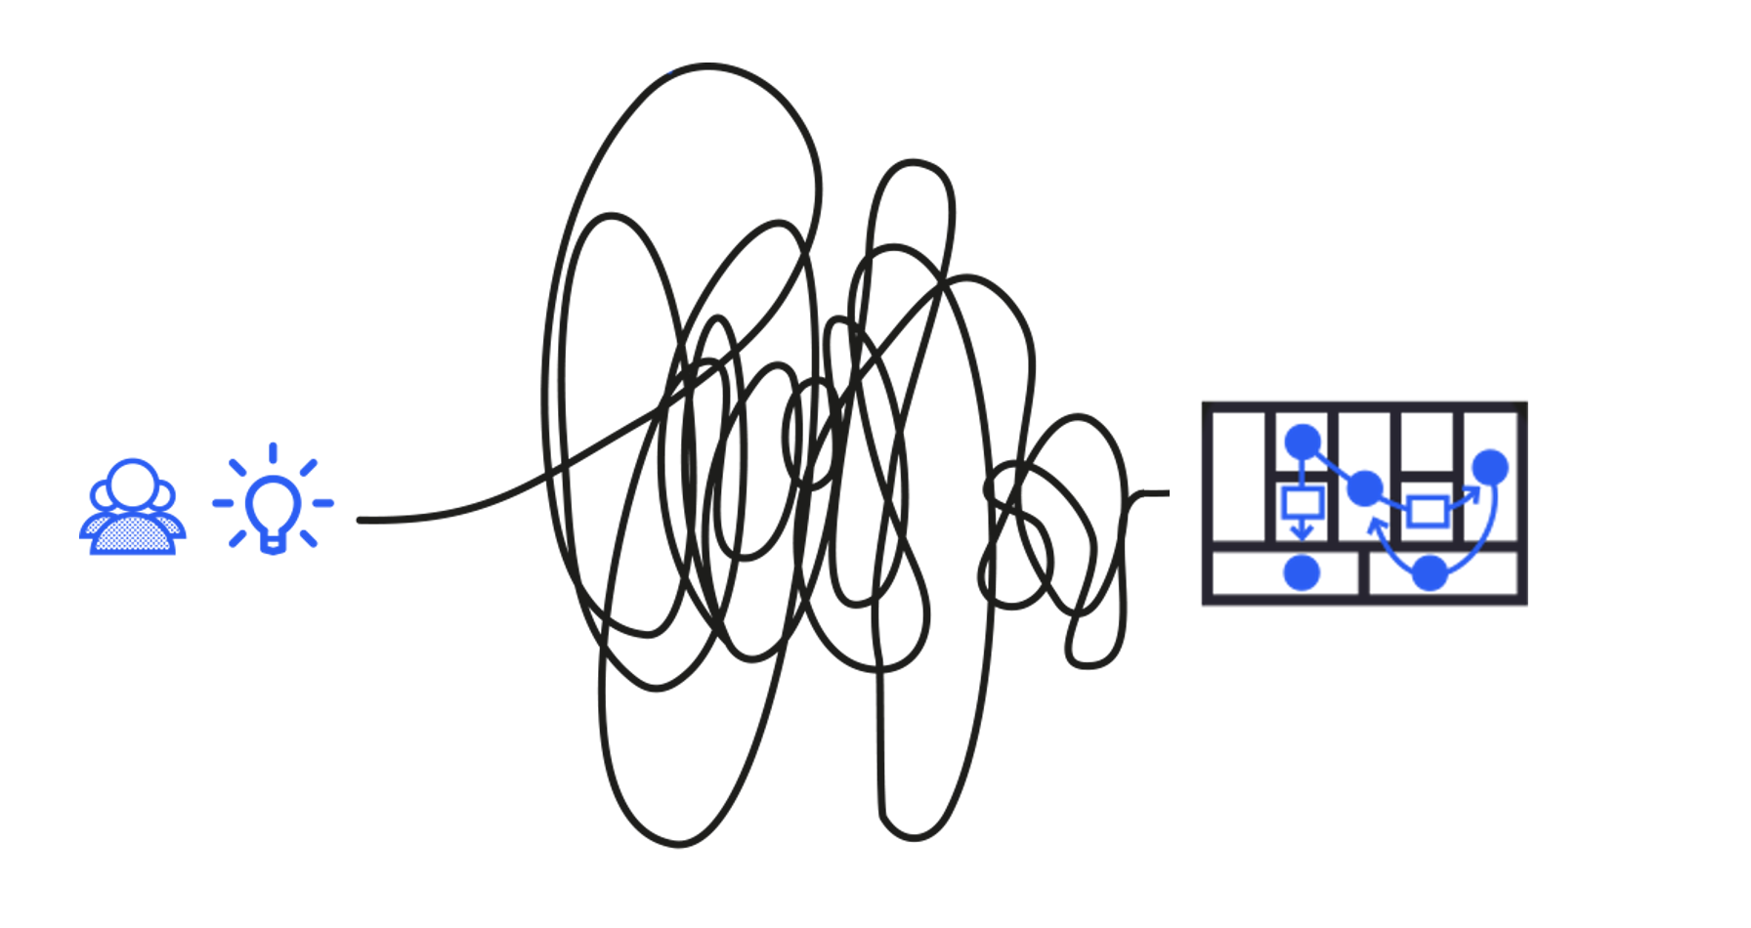

New Venture Building
Invent a superior business model
Notes:
There are two types of patterns (INVENT – IMPROVE (SHIFT)) :
one is when we invent our idea more like a green field
and the other one more about improving a business model that we already have we call that shift patterns

Slide 46

The explore/exploit continuum
EXPLORE
EXPLOIT
High uncertainty
Low uncertainty
INNOVATION IS
VALUE CREATION
NOT TECH OR R&D
Notes:
The last piece as introduction i would want to emphasize is let's not fall in love with technology while technology is a great enabler and can be the foundation of innovation.
What we really do in innovation is create value for customers and value for our organizations. That's a much larger domain than technology innovation and technology can may or may not be a driver.

Slide 47
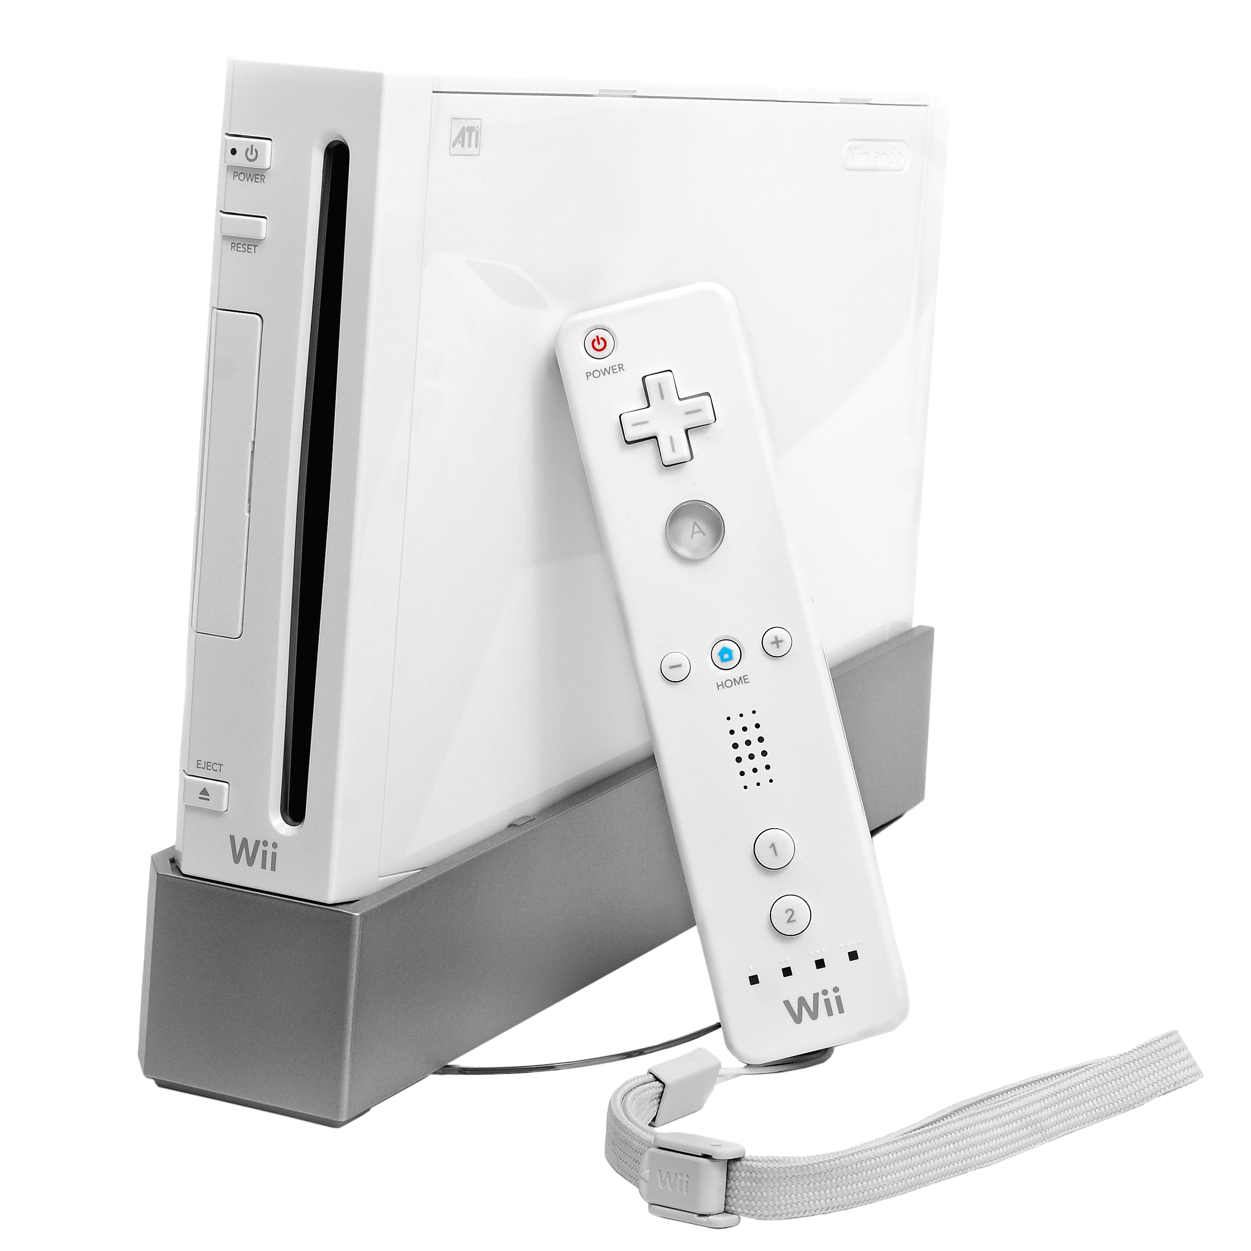
The explore/exploit continuum
EXPLORE
EXPLOIT
High uncertainty
Low uncertainty
INNOVATION IS
VALUE CREATION
NOT TECH OR R&D
Notes:
Let me give you an EXAMPLE. Think of it maybe type into the chat window what was a company that disrupted an entire industry with inferior technology when they launched the product the product was technologically inferior to competitors yet they disrupted the industry.
What i was thinking of is the nintendo wii when nintendo launched the nintendo wii.

Slide 48

The explore/exploit continuum
EXPLORE
EXPLOIT
High uncertainty
Low uncertainty
INNOVATION IS
VALUE CREATION
NOT TECH OR R&D
Notes:
They used off-the-shelf non-proprietary technology what they did right was serve an underserved market of casual gamers with motion control with very simple games because casual gamers don't care about graphics or computing power. So they figured out how to make a cheaper device for a larger market so this became a profit spitting machine based on inferior technology. So again don't get me wrong i'm not saying we shouldn't do technology innovation but just realize innovation is much larger okay which may or may not use technology. So that is the last thing i want to say kind of as a foundation of what we're going to do.

Slide 49
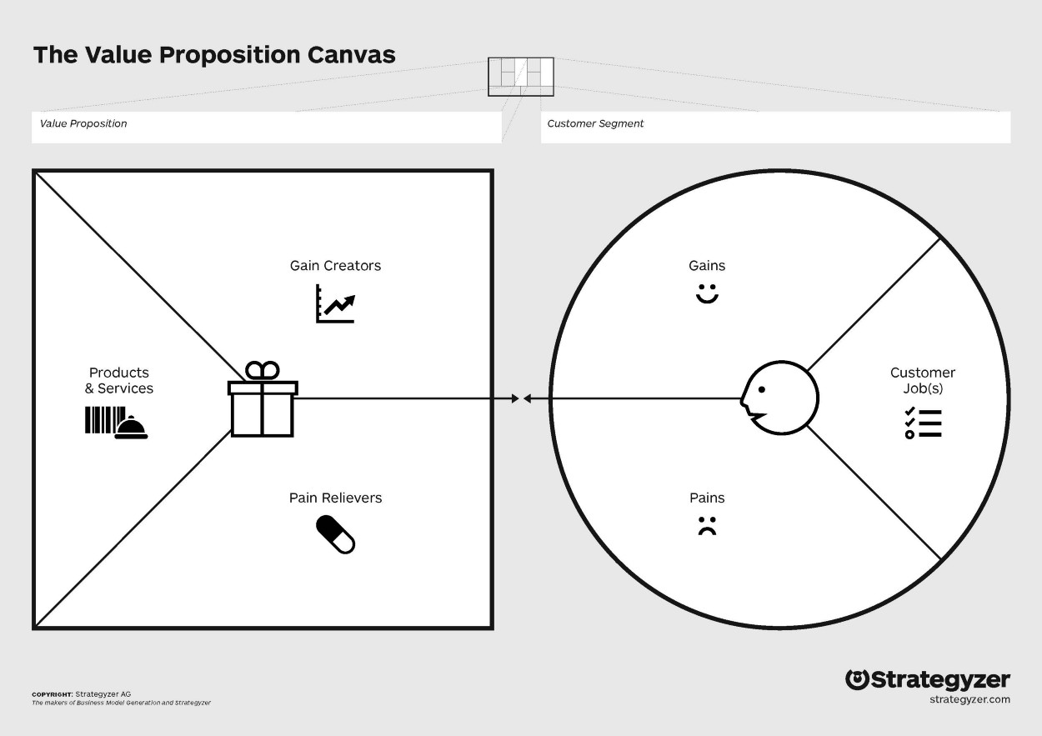
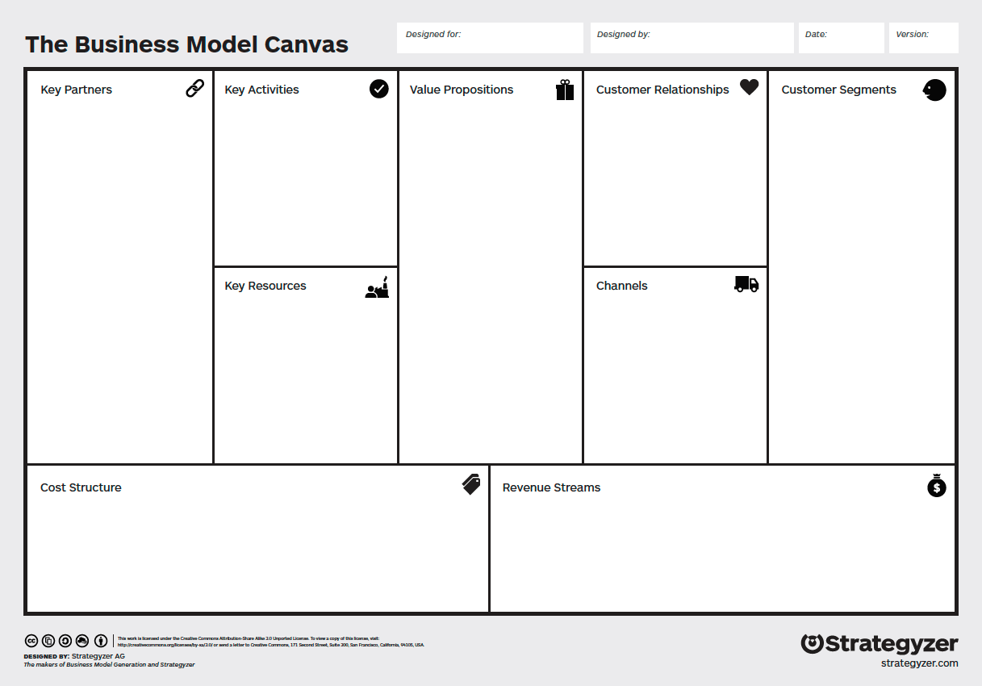
Success =
Sound Execution
+
+
Notes:
COPY:
At the end of the day, success is pretty simple:
it's a great business model,
a great value proposition,
and sound execution.
I believe this (SOUND EXECUTION) is probably the easiest one here.
What's difficult is:
A VALUE PROPOSITION that actually creates value for the customer
TO FIND A BUSINESS MODEL that can scale profitably
This is the fuzzy process that we go through in terms of business design loop.

Slide 50
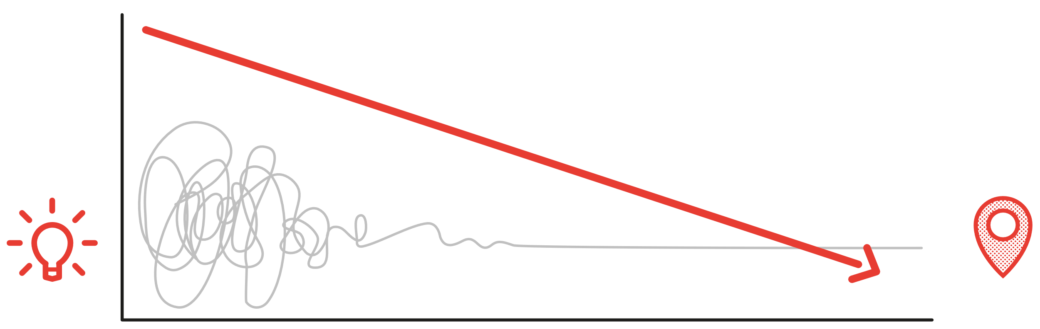


New Venture Building
The innovator’s #1 task is to reduce risk and uncertainty
Risk &
Uncertainty
Risk &
Uncertainty
Idea
Search & Testing
Execution
Business
Discovery
Discover if your general direction is right. Test basic assumptions. Get first insights to course correct rapidly.
Validation
Validate the direction you’ve taken. Confirm with strong evidence that your business idea is very likely to work.
Notes:
COPY:
We should never track the number of ideas because ideas are just fantasies. The entrepreneur’s and innovator’s FIRST task is to reduce risk and uncertainty.
We need to track:
how much have we reduced the risk of the idea
how much closer have we moved to a real business.
That might sound abstract, but we can actually do it.
Testing reduces the risk of pursuing ideas that might not work in reality. You test ideas through quick experiments that help you learn and adapt. We use Strategyser's extensive testing library to make your ideas solid with evidence. Test thoroughly to avoid wasting time, energy, and resources on unworkable ideas.

Slide 51

Run experiments from idea to business
Notes:
You can use business experiments to work almost like a scientist to test and adapt your business ideas, your product, services, value propositions and business models.

Slide 52




We usually start with this discovery sequence
Sales Force Feedback
Use Sales Force Feedback to find a pattern of customer behavior.
Discussion Forums
Search Discussion Forums for evidence of customers seeking out solutions to a problem.
Search Trend Analysis
Search online for volume around a specific job, pain, or gain.
Customer Interview
Use the quotes from your interviews to inform your search criteria.
SLIDE 52
Notes:
But it's not enough just to talk to customers in a customer interviews
WHAT'S INTERESTING IS WHEN YOU START TO MAKE THIS AS A SEQUENCE
so maybe before a customer interview:
you looked at discussion forums
maybe you talked to your Salesforce
maybe you went to Google and did a search trend analysis
that's before we do customer interviews
Or after you maybe go on and look at:
a day in the life of you shadow-like an ethnographer you shadow your b2b your business to business or your business to consumer to learn about them or
you do paper prototypes etc
it's all about the sequence of your experiments and how you move through those.
I will give you some more types of experiments a little bit more sophisticated interview techniques and then I'm gonna get you to do an exercise!

Slide 53

Customer Interview
Find interviewees among early adopters
Innovators
2.5%
Early
adopters
13.5%
Early
majority
34%
Late
majority
34%
Laggards
16%
Source: Start with Why

Slide 54

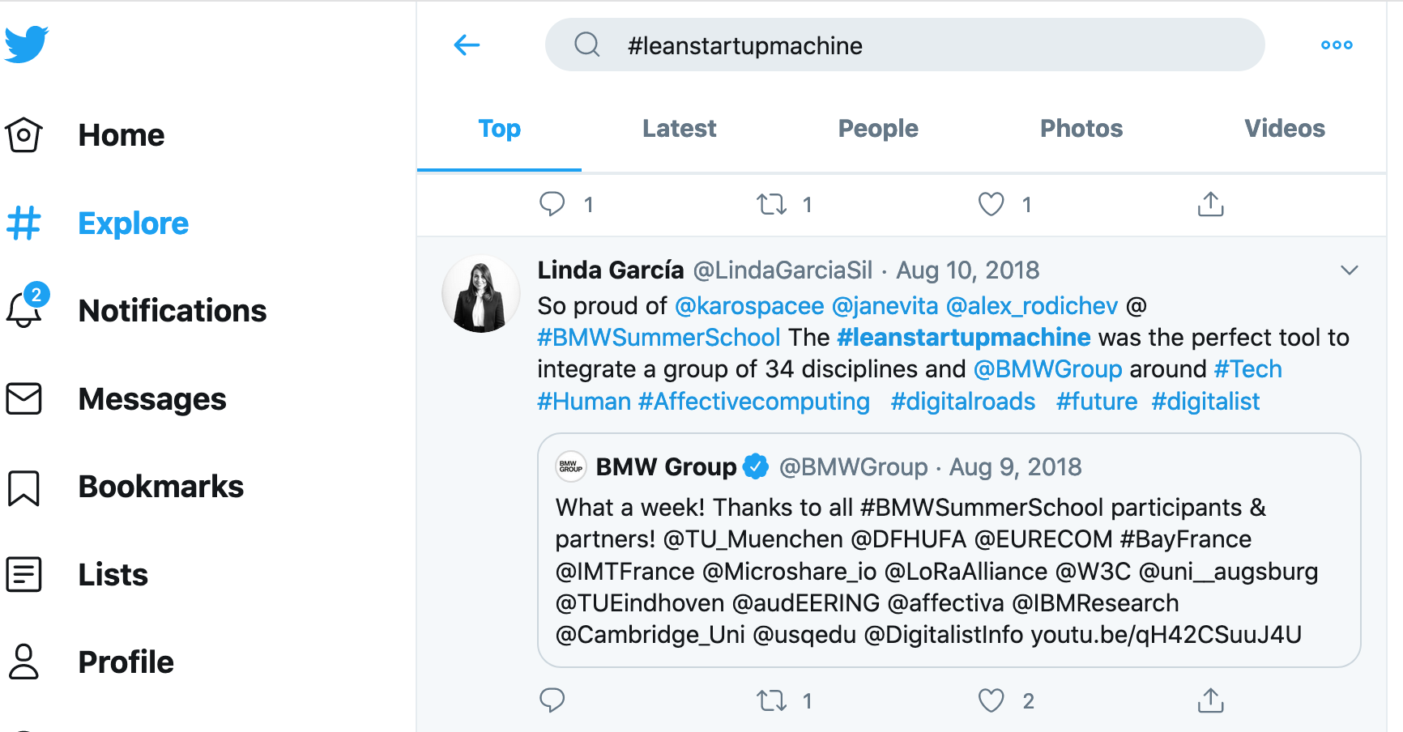
Customer Interview
How can you identify early adopters?
CASE:
SLIDE 54
Notes:
Crossing the Chasm

Slide 55

Customer Interview
How do you ask interview questions the right way?
When‘s the last time you …
Would you use this?
Have you ever googled for a solution to this problem?
SLIDE 55
Notes:
People who are not trained to do good customer discovery will immediately start asking interview subjects questions like:
“Do you like this idea?”,
“Which solution do you prefer?”,
“Would you buy this?”.
These questions will solicit opinions. Yet, experience shows that people rarely do what they say.
Your questions should instead probe for hard facts. For example, don’t ask, “What do you think the challenge is?”.
Instead you can ask:
“When is the last time you struggled with this particular challenge?,
“Can you describe what you were wrestling with, the last time you faced this challenge”, or,
“When is that last time you googled a solution for this particular problem?”.

Slide 56
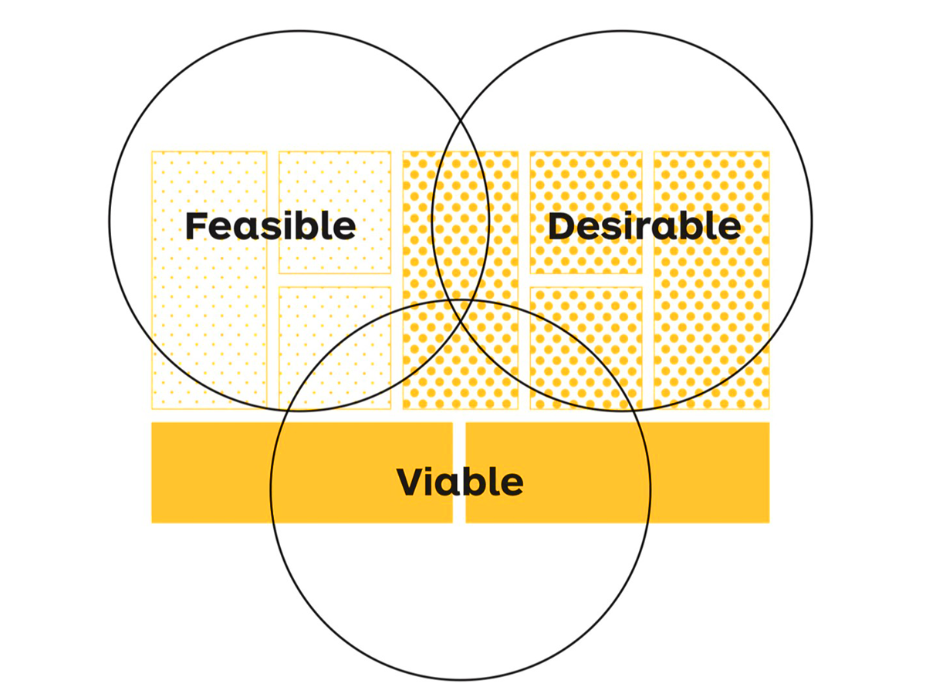

SLIDE 56
Notes:
It was overlaid over the business model canvas

Slide 57
Startup’s valuations lack standard methods, relying on rough calculations and negotiation-based final numbers.

Slide 58
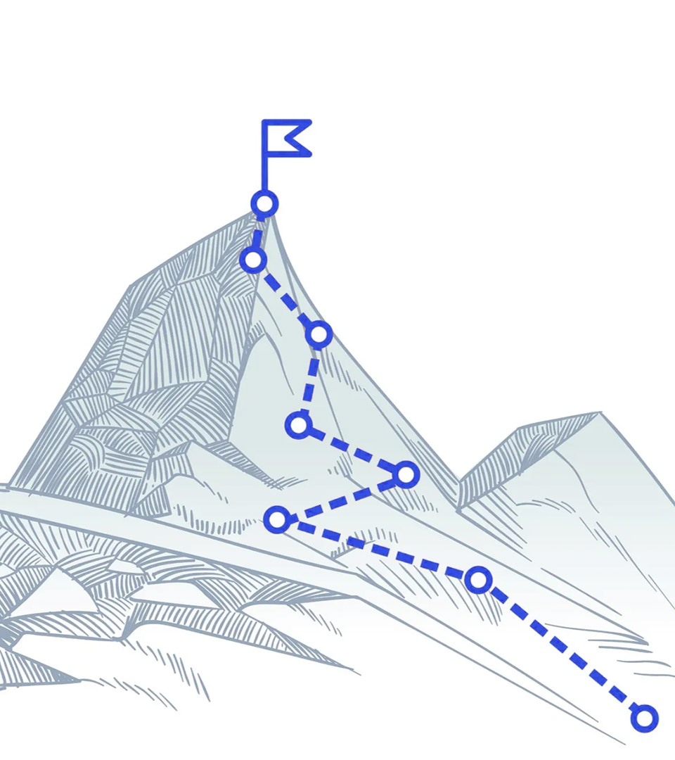
Scaling a Business
A business plan
is a map to your
destination
SLIDE 58

Slide 59
Any questions?
Let’s talk about opportunities.
Our track record demonstrates that by establishing the right structures and pairing them with the right people, your innovation initiatives can thrive.
Ready to start your business venturing journey? Let’s connect now.
Check out our website
https://venturefactory.org
Get in touch. Contact our sales team.
info@venturefactory.org

