Slide 1

UNIVERZA V MARIBORU : Vloga slovenskega gospodarstva v evroMARIBORpskem raziskovalnem prostoru in priložnosti za mednaarodno sodelovanje (1)
Doc. dr. Draško Veselinovič,
predsednik UO Slovenian Business and Research Association, Bruselj

Slide 2

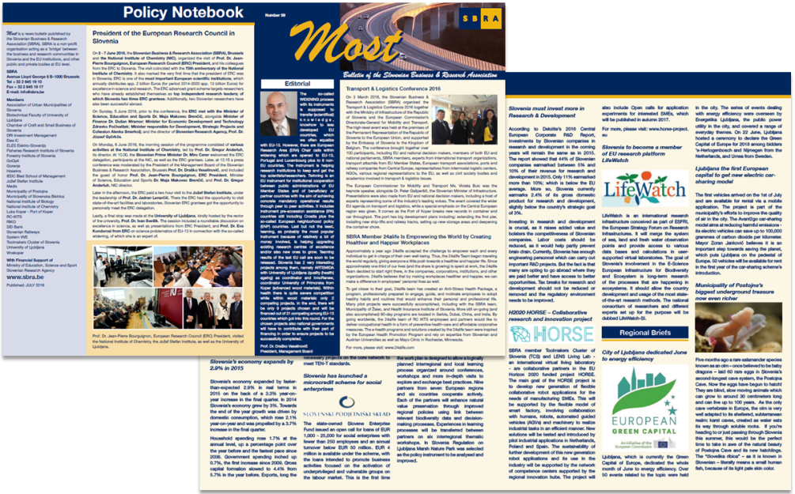
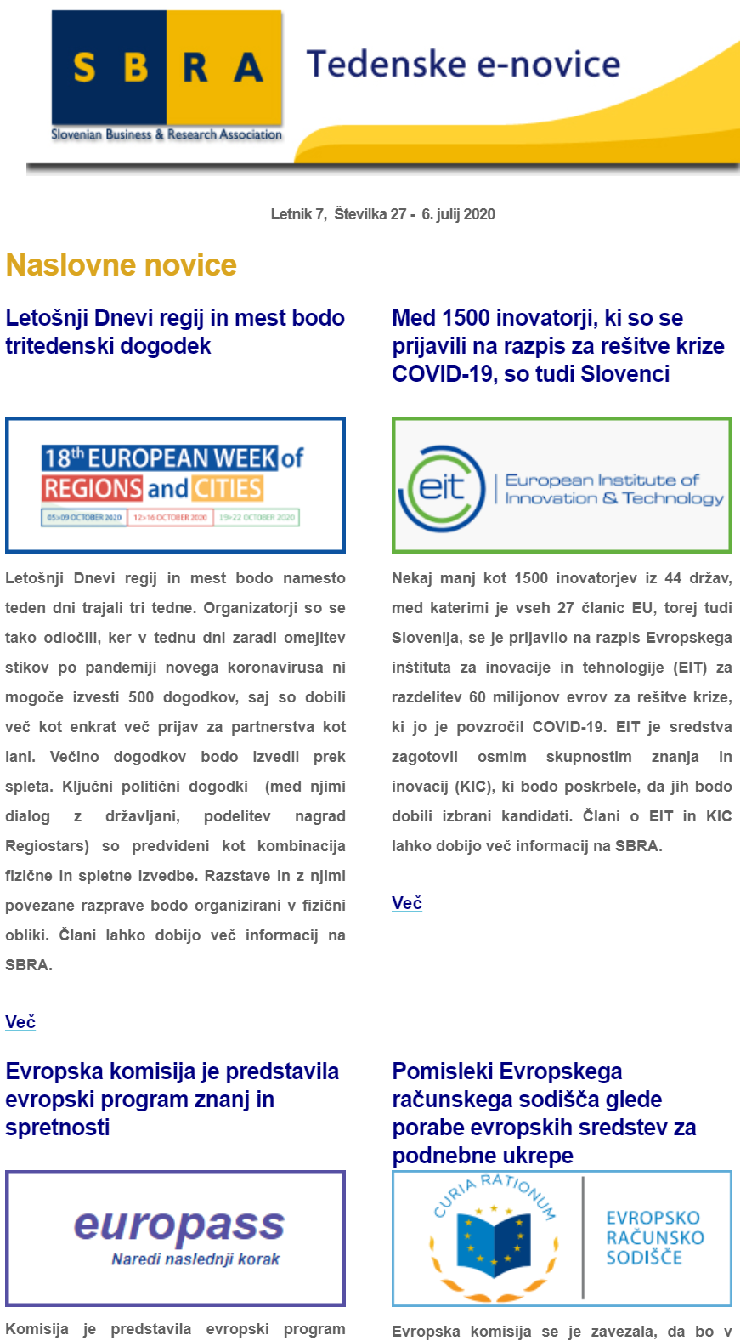
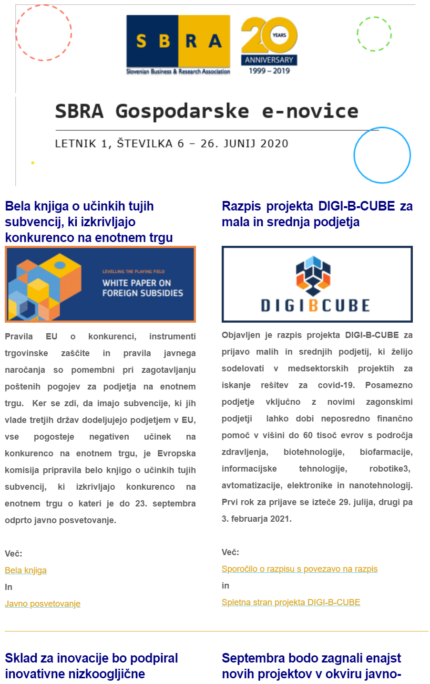
SBRA CORE ACTIVITIES
Informing members on economic developments, with a renewed focus on EU projects, programs and funds. A weekly scan of news, relevant calls, events, publications, etc. – disseminated via weekly e-news bulletin. Additional, bimonthly news bulletin regarding the economy. Publication MOST allows us to disseminate our members’ achievements widely.
EU projects —Partner search. In addition to informing members of relevant EU programs and projects, we actively strive to find and search for relevant partners and potential project consortia. Project networking, brokerage events, partners’ matching, pitches, … and checking out the application before submission.
Training – preparing workshops and study trips, meetings for its members.
Activities in important European networks – Secretariat of Network of European Financial Institutions for Small and Medium Sized Enterprises (NEFI), membership in IGLO (Informal Group of RTD Liaison Offices), ERRIN (European Regions Research and Innovation Network), UnILiON (Universities Informal Liaison Offices Network), Vanguard initiative (regional network for promoting regional innovation ecosystems) and ENDR (Network of Defence Related Regions).
Conferences, promotional and brokerage events, workshops, working meetings, publishing reports and organising conferences.

Slide 3
The Future of European Competitivness = Draghi‘s report 1/3
GDP growth in this century is twice as high in the USA than in the EU
EU GDP represents 17% of the world’s total, China also 17% and USA 26%
Trade (protectionism + Brexit), energy (high prices) and also, to a certain extent defence, which supported growth in the EU in the past, are fading away
Many crises (Lehman brothers, COVID, energy) in the last 20 years that struck Europe
How to close the innovation gap towards the USA and China, especially in advanced technologies
There is no EU company worth more than 100 billion euros that developed in the last 50 years from scratch
There are enough good researchers and innovators in Europe, but we lack commercialisation of their ideas and products owing to too much regulation and lack of seed, venture and similar sorts of capital
A consequence of the lack of venture capital - many European unicorns (<1 billion euros worth) go to the USA
Energy prices in Europe are much higher than in the USA, but decarbonisation is an opportunity for Europe; Europe is the world leader in clean technologies and decarbonisation
Increasing security (2nd largest world spender, but still not safe - defence industry too fragmented) and lowering dependency (energy, raw materials, chips) are correct and only true challenges for Europe

Slide 4
The Future of European Competitivness = Draghi‘s report 2/3
Many countries in Europe strongly started their own different national policies
Savings (1.400 bn euros) are higher than elsewhere, but the wealth of the people is growing slower than elsewhere
The EU single market is still too fragmented and very regulated
European industrial policies and strategies are too complex and difficult to have a common one; decision-making in the EU is very slow and also sometimes vetoed (19 months to adopt a directive)
Too low public spending on R&I and insufficiently focused on break-through innovation
Horizon is spread over too many fields and too complex and bureaucratic, led by EC and not really by top researchers and scientists; it is too little coordinated within different parts and for the largest projects (CERN, EuroHCP, by contrast, are good examples good EU coordination)
EIC Pathfinder has a budget of 256 mio euros, USA 6,1 billion euros for a similar purpose

Slide 5
The Future of European Competitivness = Draghi‘s report 3/3
New Industrial strategy with 4 “building blocks”:
- Full implementation of the Single market
Industrial, competition and trade policies, which interact closely and must be aligned as part of an overall strategy
Financing the main areas for action, which entail massive investment needs unseen for half a century in Europe
Reform the EU’s governance, increasing the depth of coordination and reducing the regulatory burden
At the same time, preserving social inclusion (low inequality, cohesion, …)
Adopting modern and adaptive, flexible, case-by-case common EU trade policy incl. FDI
Awareness of traps of protectionism and taking into account mistakes from the “hyper globalisation” times

Slide 6
Closing the innovation gap
Increase in productivity (watch out: EU is losing 2 mio workforce per year)
Integrating AI vertically into the European industry (EU lost the game in digitalisation already)
Europe’s social and health policies represent strong pillars compared to others; the idea is to keep them - Europe has the least inequality in the world
Europe needs massive investments to overcome explained barriers and to boost innovations:
Higher productivity releases some fiscal space, which could then finance more R&I
Common developed Capital Markets Union
More investments in some good common EU public goods, like breakthrough innovation, will be necessary
Suitable investments in joint cross-border EU investments like defence procurement and grids

Slide 7
Next EU Framework Programme With Existing Problems
The EU (20% of all in the world) in front of the USA and behind China in scientific publishing
Top 3 R&I spenders in the USA: Alphabet, Meta, and Microsoft (software), while in the EU: VW, Mercedes-Benz, Bosch (auto)
Just 5 countries exceed 3% investments for R&D in the EU: Belgium, Sweden, Austria, Germany and Finland
The EU is lagging behind with private investments in the R&D, public one is comparable to the competition, and even that is fragmented, not necessarily aligned with the common EU priorities, difficult to get, too many areas/priorities, research infrastructure fragmented and in many cases duplicated or even more so, lacking excellence
Researchers are not keen to become entrepreneurs or at least to more enthusiastically work with them as partners on new breakthrough innovative products
In the EU, there are numerous clusters, but they generate less value than in the USA and China (Europe is more in traditional industries)
Financing problems for the EU innovative SMEs development and scale-up (lack of venture capital, capital market IPOs, going abroad, usually USA)

Slide 8
Suggestions for Research & Innovations…
A smaller number of commonly agreed priorities
Increased budget (200 bn euros from today 95 bn euros) should be allocated efficiently towards disruptive innovation, EIC should become a “unique” USA-like agency ARPA, high-risk/high-awards
The governance of the programme by proven project managers with a focus on young, innovative companies
The application process shorter and less bureaucratic
Better coordination across EU member states
Establish consolidated European academic institutions at the forefront of global research (ERC is a good example and “the new ERA Chair”)
Inventors to become investors with the facilitation of scaling up (EU unified, easier to achieve intellectual property, Statute “Innovative European Company”)
Better financing possibilities for start-ups and scale-ups (deeper pool of business angels, seed, venture and other investors, developed capital market for start-ups, more money for EIC, and EIF (EIB))

Slide 9
…and industrial policy
Lower the cost of AI deployment by increasing computational capacity and its network of high-performance computers
Promotion of cross-industry coordination and data sharing to accelerate the integration of AI into European industry
Consolidation in telecom sector to deliver higher investments in connectivity
Sustaining and expanding R&I will also be crucial for key manufacturing sectors (pharma, automobile, defence and more and more also space)

Slide 10
Closing skills gaps
Shortage of labour in all respects
Education systems are in national domains and are lagging behind (especially in high-tech , what slows down decarbonisation, digitalisation, AI)
Redesign of national education systems to more forward- and modern tech-oriented

Slide 11
Decarbonisation and competitiveness plan
The EU decarbonisation plan is more ambitious than its competitors,’ creating additional short-term costs for the European industry
Opportunity for Europe to lower energy prices and take the lead in clean technologies (“clean tech”) and also becoming more energy secure (renewables in EU 22% of all energy, China 13% and USA 9% and nuclear); however, not necessarily demand for clean tech will be met by the EU supply because of cheaper Chinese products)
How to decarbonise and preserve a competitive position of the industry is the question for the EU

Slide 12
The threat to Europe’s clean tech sector 1/2
Leading world position of the EU in this sector squandering early-stage advantages owing to the weaknesses in its ecosystem
Europe’s innovation potential is not translating into manufacturing superiority for clean tech despite the size of its domestic market
The threat to Europe’s clean tech sector owes mainly to a lack of an industrial strategy equivalent to other major regions
The EU’s improving outlook for its batteries industry demonstrates that a focused policy effort can succeed, even if non-EU players may benefit most
Transport can play a critical role in European decarbonisation whether it proves to be opportunity depends on planning
The automotive sector is a key example of lack of EU planning, applying a climate policy without an industrial policy (lack of coordination and broader and deeper overall support)

Slide 13
The threat to Europe’s clean tech sector 2/2
To capitalise on the decarbonisation push, Europe should refocus its support for clean tech manufacturing, focusing on tech where it either has a global lead or where there is a strategic case for developing domestic capacity
The EU must develop an industrial action plan for the automotive sector
The EU cross-border sustainable transport must follow not only cohesion but especially competitiveness goals

Slide 14
Sectoral and Horizontal Policies
Sectoral policies:
Energy, critical raw materials, Digitalisation and advanced technologies, high-speed/capacity broadband networks, computing and AI, Semiconductors, energy-intensive industries, clean technologies, automotive, defence, space, pharma, transport
Horizontal policies:
Accelerating innovation, closing the skills gap, sustaining investment, revamping competition, strengthening governance, financing investment

Slide 15
Financing investment
Very high savings which are not efficiently channelled into good productive sustainable invesments
Capital market segmented and not efficient enough, especially for the innovative SMEs
Mainly bank financing
EU budget still not large enough and has too conservative attitude toward risk
Capital Market Union (CMU) needs the issuance of a common safe asset (=financial instrument) with a clear and transparent reference rate and good liquidity
CMU needs liquid debt instruments like bonds for some joint large projects like 250 bn euros green bonds for the NGEU in the 2021-2027 budget
CMU needs pension funds support in all respects
For the next EU budget (2028-2034), the “Competitiveness Pillar (Fund)” to direct EU funding towards priority projects under the Competitiveness Coordination Framework
Bringing in and supporting much more private capital investments in all EU activities

Slide 16

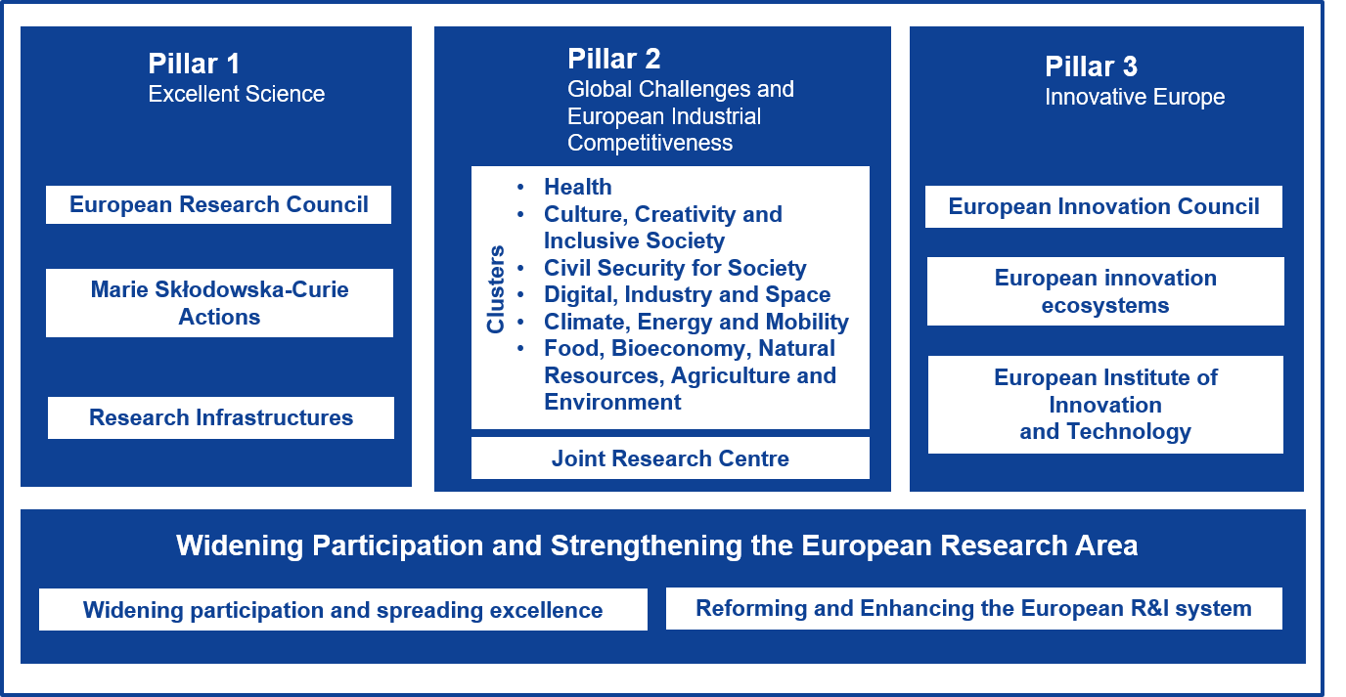
Structure of the Horizon Europe

Slide 17





Adaptation to climate change, including societal transformation
Healthy oceans, seas, coastal and inland waters
Cancer
5 mission areas
+ Bauhaus
Climate-neutral and smart cities
Soil health and food

Slide 18
New European Research Area (ERA) from 2021
ERA is behind its key priorities, lagging behind the main competitors (USA and China)
Spending for R&I (2,3% of GDP) for the EU is quite o.k., but still lagging behind the USA (3,6%) and South Korea (5,2%) - the figure for the EU would be lower without the NGEU and within it, especially without RRF
Sharing research infrastructure is progressing, although most of the EU members don‘t have financial and organisational resources to build, operate and upgrade such infrastructure
ERA forum shows a good and positive atmosphere in different important discussions, exchange of views, learning from each other and also criticism and also shows that without national support and commitment, EC cannot do much and/or at least not enough
ERA actions

Slide 19
EU BUDGET 2014-20 : EU BUDGET 2021-27
Categories for: | 2021 - 2027 | Categories for: | 2014 - 2020
Single Market | 144 | Competitiveness for growth and jobs | 125,6
Cohesion and resilience | 1,100 | Economic & Territorial Cohesion | 324,9
Natural resources and the environment | 374 | Sustainable growth: natural resources | 372,9
Migrations and borders | 23
Security and defence | 13 | Security and citizens | 15,7
Neighbourhood and world | 98 | Global Europe | 58,7
EU administration | 73 | EU administration | 61,7
TOTAL | 1,824 | TOTAL | 959,5

Slide 20

Thank you!
Slovenian Business & Research Association
Rue Belliard 40
1040, Brussels, Belgium
tel: +32 496 556131, +386 41651004
drasko.veselinovic@sbra.be
www.sbra.be

