Slide 1



This project has received funding from the European Union's Horizon 2020 research and innovation programme under the Marie Sklodowska-Curie grant agreement no. 956265.

Slide 2

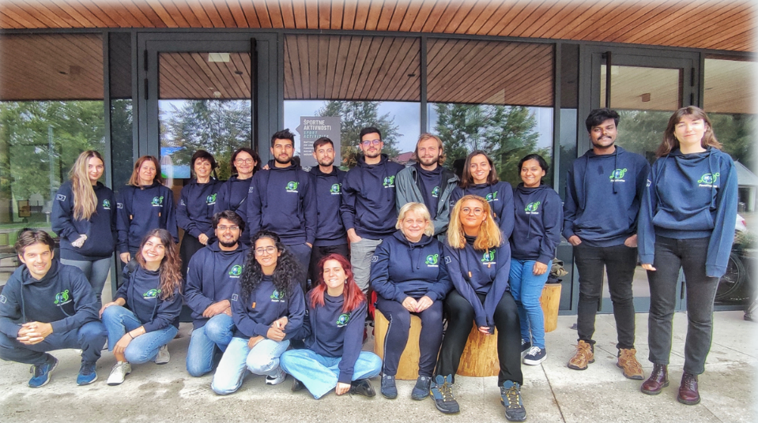

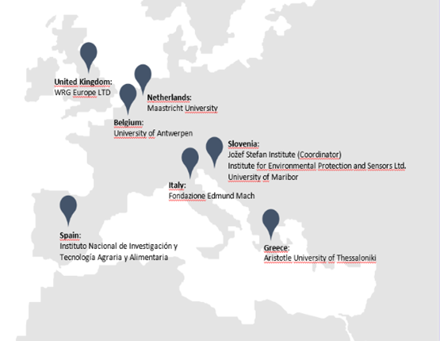
Who are we?
15 Early-Stage Researchers and coordinators
Provides high-level training in new techniques including mass spectrometry
Why?
Ensuring everyone has enough safe and nutritious food
Finding ways to reduce waste and reuse resources
Making food healthier to improve our well-being
Using Nanotechnology to boost food safety and quality
Notes:
A circular economy is a model of resource production and consumption in any economy that involves sharing, leasing, reusing, repairing, refurbishing,

Slide 3
Finding out about FoodTraNet
Finding This Opportunity
Online research (MSCA website, Funding and Tenders Portal)
University resources (research office, mentors)
EURAXESS portal (job listings, hosting offers)
Application Process
Researching the program and identifying suitable projects
Preparing the application (CV, cover letter, research proposal, letters of recommendation)
Seeking guidance (mentorship, institutional support)
Submitting the application and preparing for interviews

Slide 4
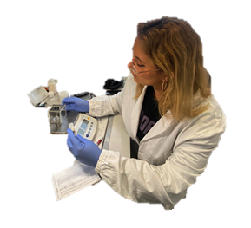









ESR6: About me and my ESR journey
Cathrine Terro
2022
PhD (MSCA Fellow)
ESR – 6:
Novel strategies for verifying food authenticity and building consumer trust
2019
Masters + Research
Marie Curie secondments
2018
Clinical Work + Community Nutritionist
2017
Bachelors
Notes:
A circular economy is a model of resource production and consumption in any economy that involves sharing, leasing, reusing, repairing, refurbishing,
One of the most valuable aspects of Marie Curie projects is secondment, which means a PhD candidate temporarily goes to another project's contributing centre.
which means a PhD candidate temporarily goes to another project's contributing centre.

Slide 5
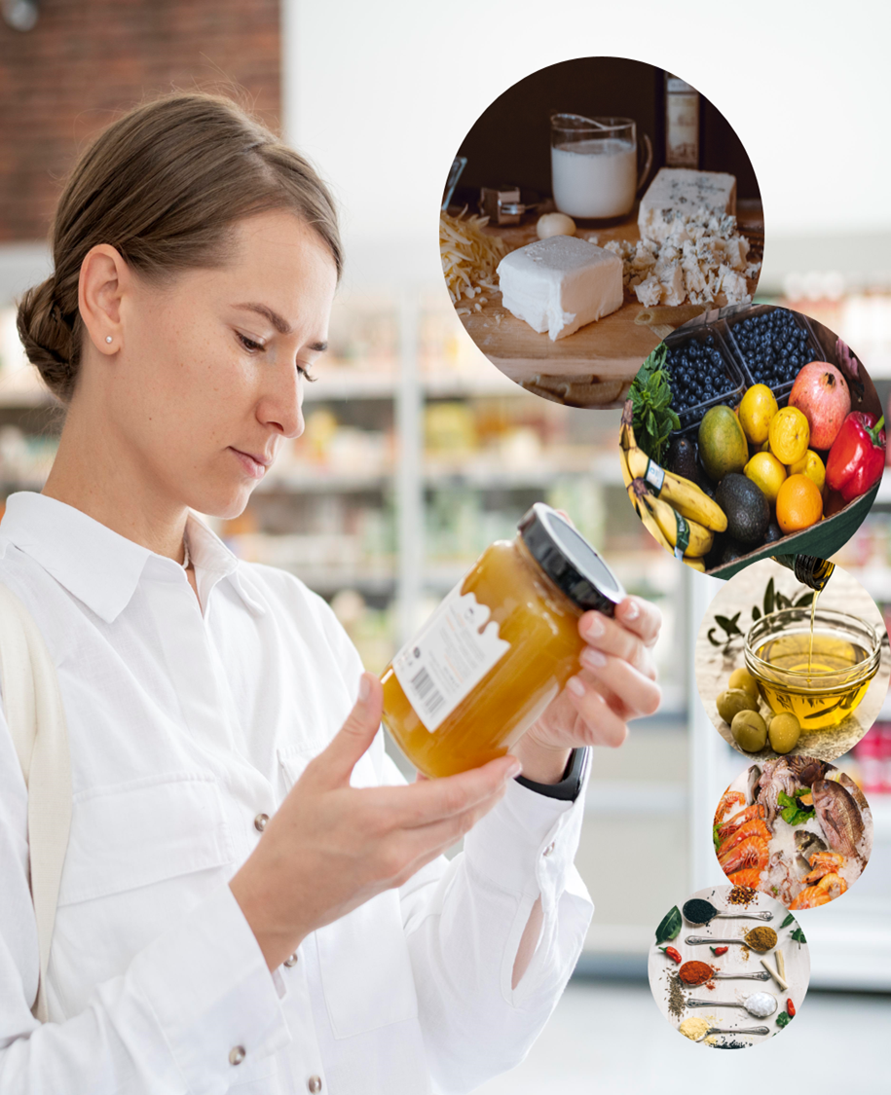




Aim
To develop strategies to ensure commercial food authenticity and traceability
Novel strategies for verifying food authenticity and building consumer trust
Where does it come from?
How real is the food we eat?
Can we trust it?
Notes:
How We Make Sure Our Food is Real
What Are Stable Isotopes?
Different “flavors” of the same element.
Why Do We Need a Database?
To ensure the food we buy is real and not fake
To ensure the food we buy is real and not fake.
How Do We Do It?
Collect Samples:
Take small pieces of real food from different places.
Analyze Isotopes:
Look at the “flavors” of elements in the food using special machines.
Build the Database:
Save all this information in a big, organized list.
Slide 2: Why Is This Important?
Traceability:
We can tell where the food came from.
Authenticity:
We can check if the food is real or if someone tried to cheat.
Trust:
People can feel safe knowing their food is what it says it is.
Conclusion:
This helps keep our food safe and honest!

Slide 6

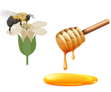



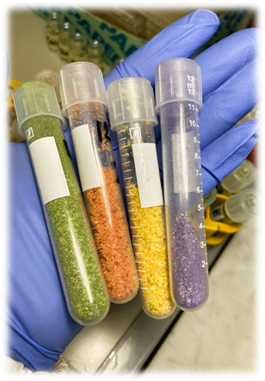

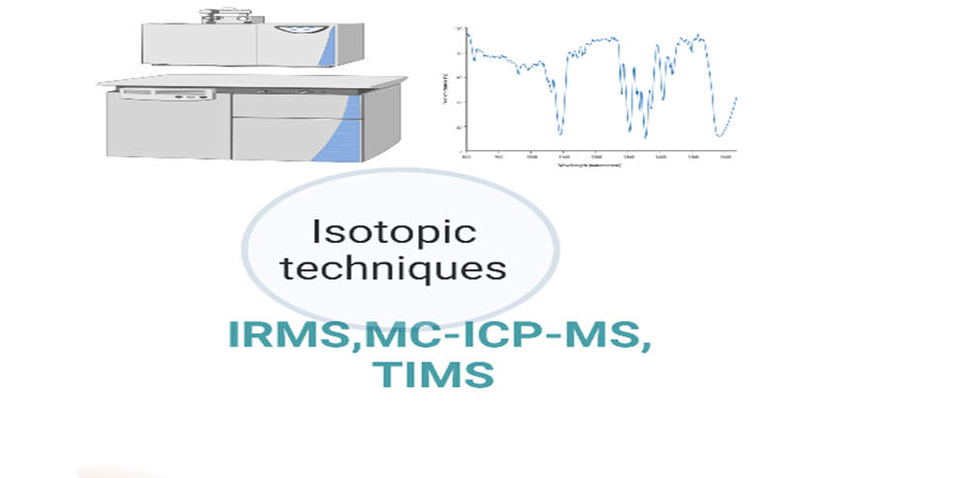
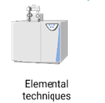
Novel strategies for verifying food authenticity and building consumer trust
We compare the food’s isotope values to our database to see if it matches where it claims to be from
If the isotope signature doesn’t match, we know the food might be fake or mislabeled
Collect
samples
Build the Database
Analyze Stable Isotopes and elements
Notes:
Stable isotopes are like a fingerprint for food
How We Make Sure Our Food is Real
What Are Stable Isotopes?
Different “flavors” of the same element.
Why Do We Need a Database?
To ensure the food we buy is real and not fake
To ensure the food we buy is real and not fake.
How Do We Do It?
Collect Samples:
Take small pieces of real food from different places.
Analyze Isotopes:
Look at the “flavors” of elements in the food using special machines.
Build the Database:
Save all this information in a big, organized list.
Slide 2: Why Is This Important?
Traceability:
We can tell where the food came from.
Authenticity:
We can check if the food is real or if someone tried to cheat.
Trust:
People can feel safe knowing their food is what it says it is.
Conclusion:
This helps keep our food safe and honest!

Slide 7





ESR13: Who I am and my journey
Athira John
ESR – 13
Marie-Curie European Training Network -FOODTRANET
Food Quality, Safety and Security
Host Institute

Slide 8
Background
2022
PhD (MSCA Fellow)
2019-22
Research projects
2018
Masters
2016
Bachelors

Slide 9
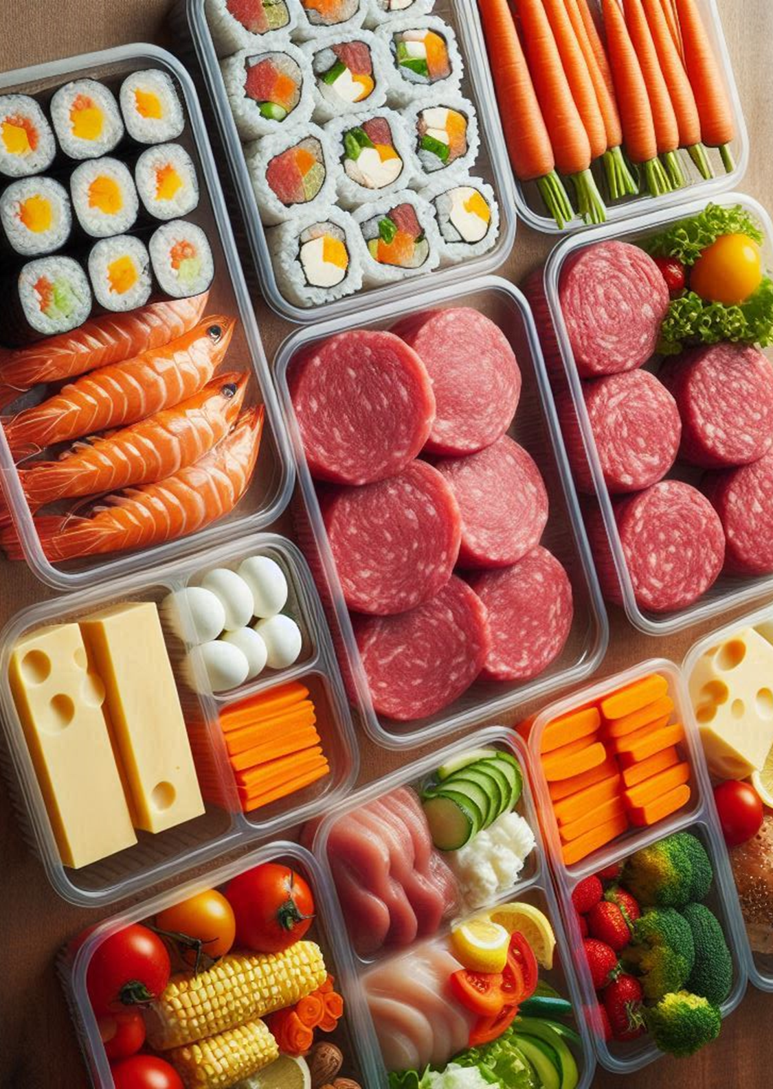
Project overview
Increased plastic waste
Increased food waste
ENVIRONMENTAL
Loss for the companies
Import & export of food to long distance
ECONOMICAL
Waste of money
Customer dissatisfaction
SOCIAL
Food packaging With Limited Shelf-Life and non biodegradability

Slide 10
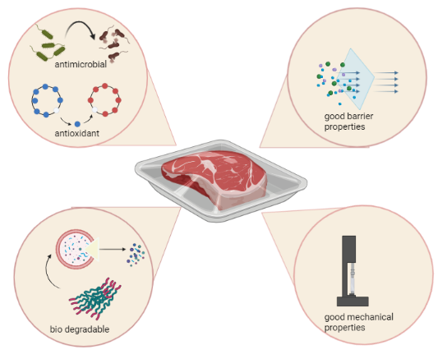
My work

Slide 11
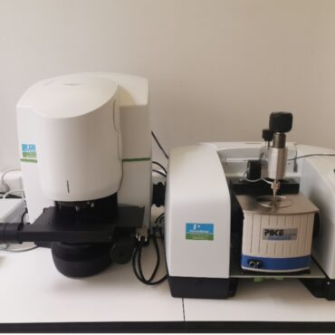
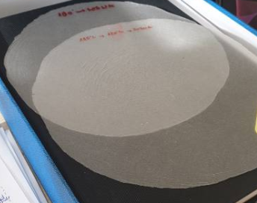
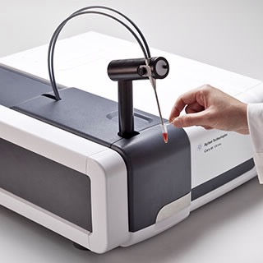
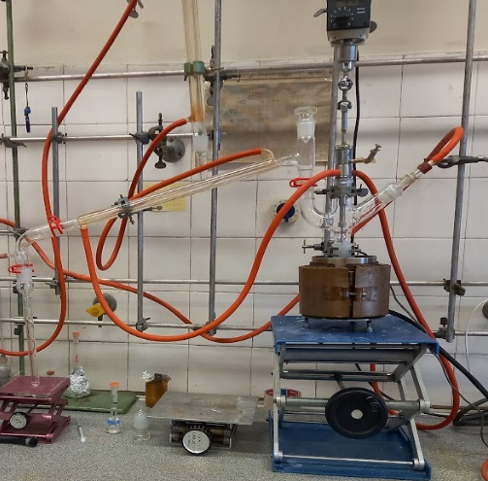
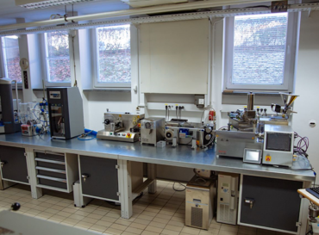
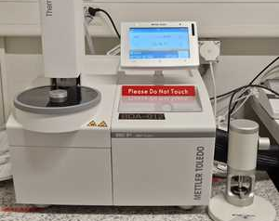
What I do
Synthesis of novel biodegradable packaging material
Development of monolayer food packaging films evaluation of their properties following ASTM/ISO standards.
Formulation of coatings from natural sources to impart antibacterial and antioxidative properties
Validation of packaging films.
Evaluation of material safety, biodegradability, compostability.

Slide 12
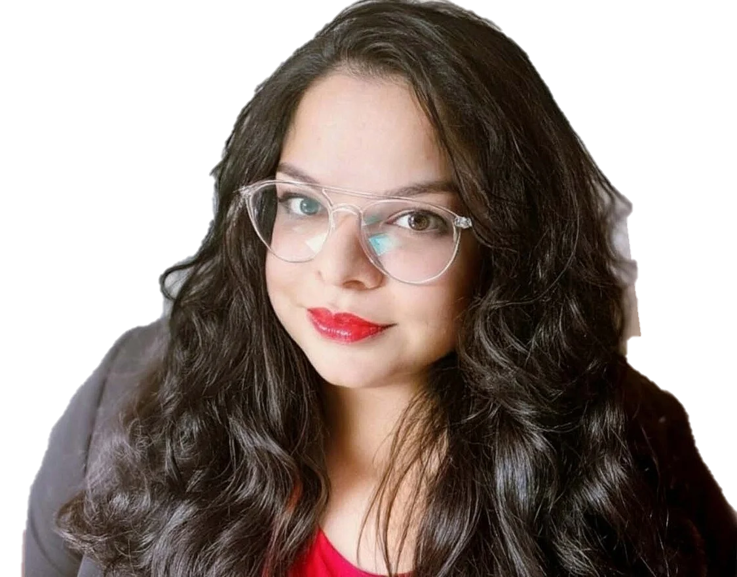








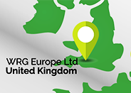



ESR15: About me and my journey
Addressing the communication gap
2013 – 2014
2017 – 2021
2021 – 2025
2012 – 2016
2015 – 2016
2019 – 2021
Easy to understand
Trust in content
Human connection

Slide 13
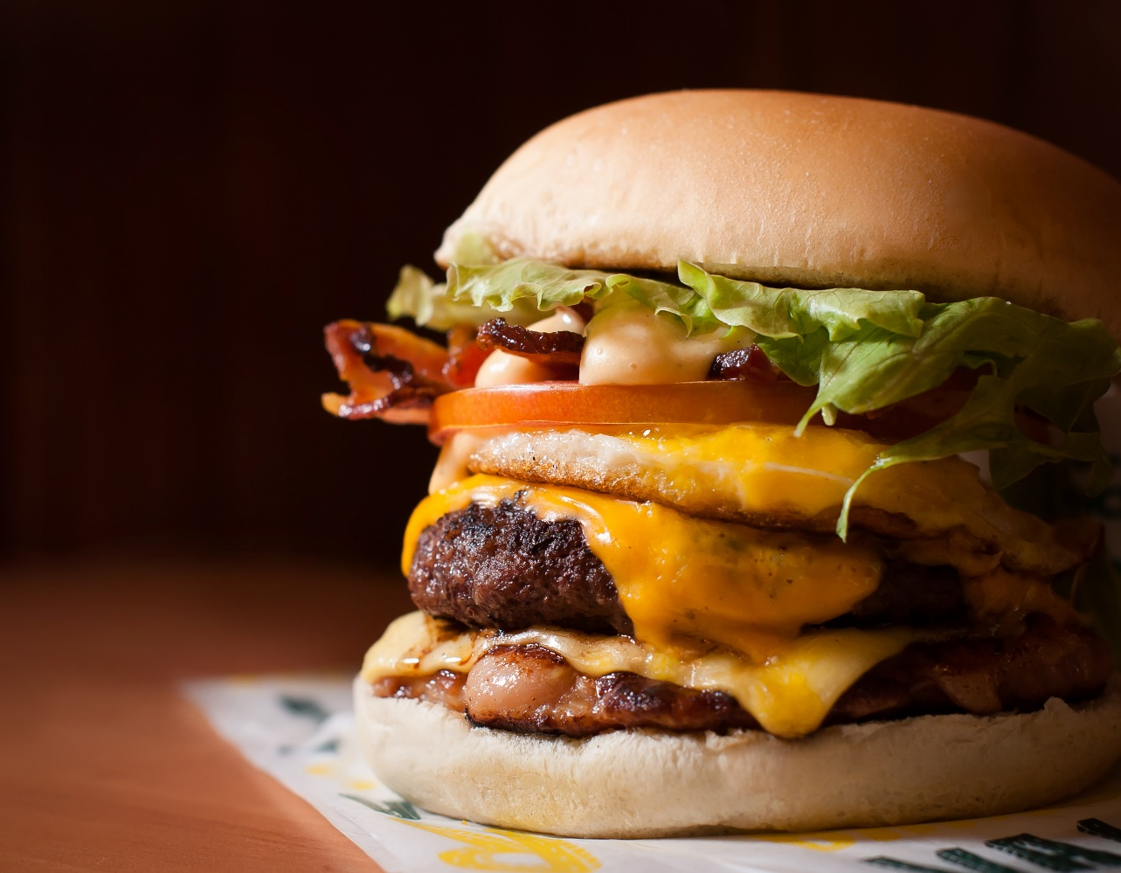
Overarching Aim
To develop new methods and models for more effective consumer communication.
4-Phase Plan
Phase I: Quantitative methods
Phase II: Qualitative methods
Phase III: Modern communication tools
Phase IV: Communication framework
Consumer awareness and perception

Slide 14
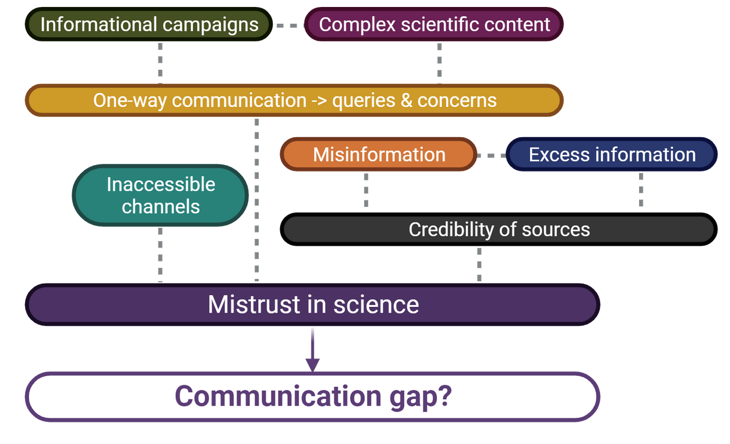

Communicating sciences to the public I
How Communication Should Be:
Accessibility
Flexibility
Creativity
Engagement
What Communication Tools Should Be Like:
Easy to Understand
Trust in Content
Human Connection

Slide 15

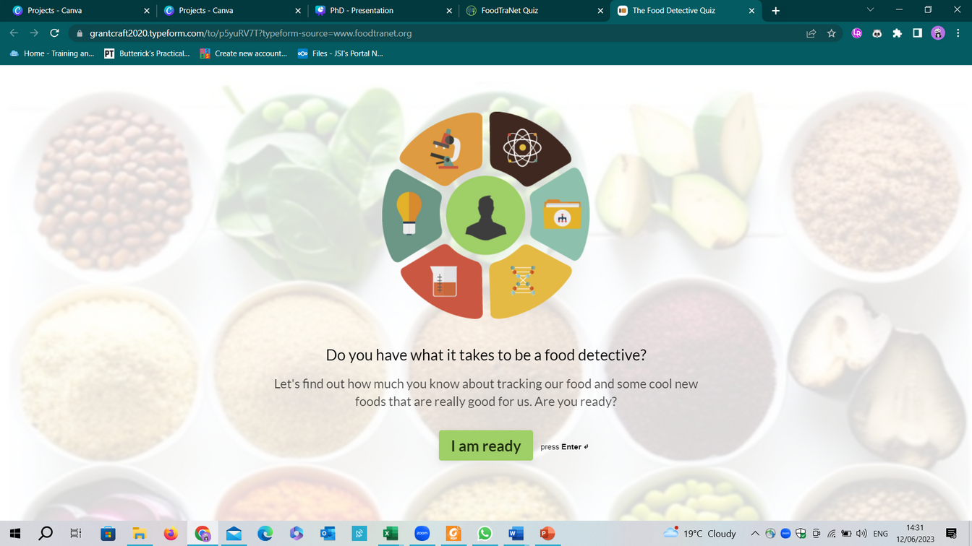
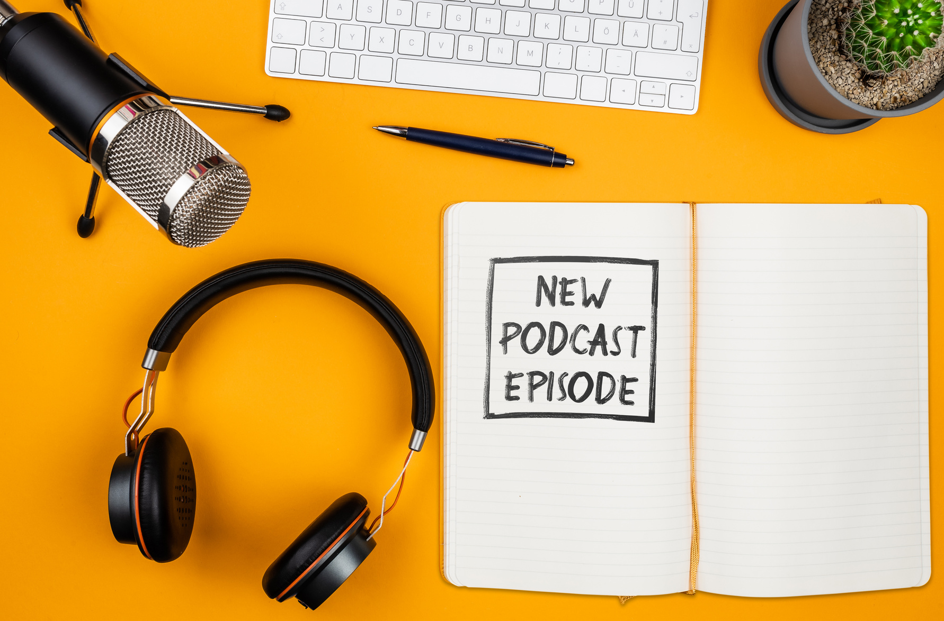
Communicating sciences to the public II
Podcast Series: Mass Spectrometry Podcasts – Communicating highly specialized sciences to the public
Interactive survey for children
on food traceability
Podcast Series: Industrial Liaison Group - Academic to Industry Perspective

Slide 16
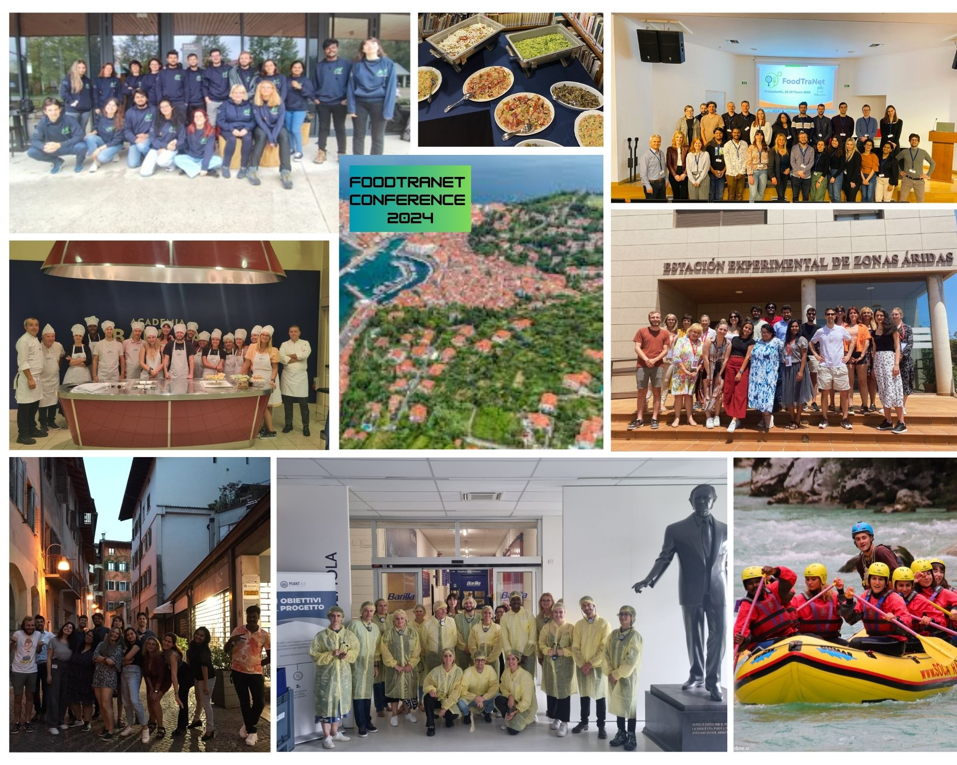
Summer & Winter School:
Advanced approaches for food quality, authenticity and traceability
Advanced solutions in food production and safety
Advanced materials in food science
Teambuilding events:
Barilla and Rafting
Final event:
FoodTraNet Conference 2024

Slide 17
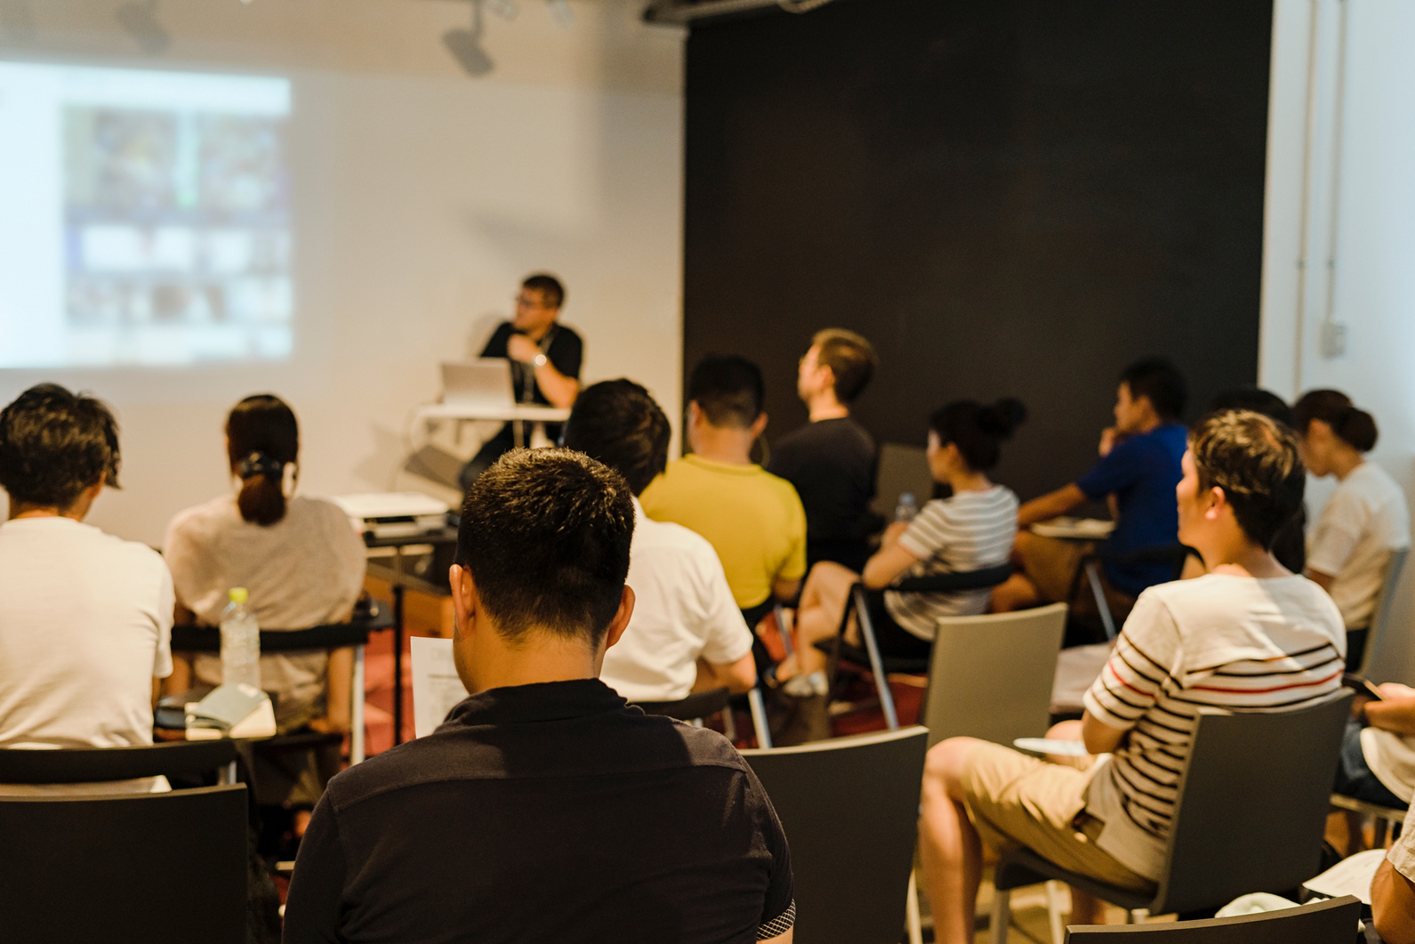

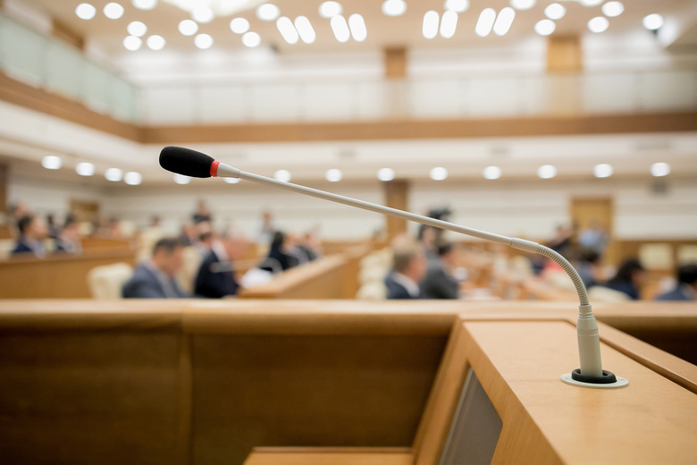


Outreach and dissemination
Workshops and
MSCA Events
Scientific publications and public deliverables
International and regional academic conferences
Social media channels
Newsletters and scientific blogging

