Slide 1



Slide 2
FP 10, SOME ESSENTIAL POINTS (1)
HOW MUCH MONEY? 200 BILLION EUROS
3% OF BDP FOR R&I (NOW EU 2,2%)
HOWEVER, MORE MONEY FOR DEFENCE AND DUAL USE PLUS FIRE SAFETY ON THE ACCOUNT OF FP10
MISSIONS (YES OR NO OR DIFFERENT ROLE, CANCER OUT, BAUHAUS IN?), NOT SO MUCH AND NOT ENOUGH RESEARCH INVOLVED? IF YES, MORE COORDINATED WITH THE HE, MORE PRIVATE SECTOR AND MORE RESEARCH, SPECIAL COMMISSIONER, REGIONAL CG
WIDENING OUT OF HE OR NOT (NO MORE TEAMING?), HOW MUCH MONEY (NOW 3,3 BILLION EUROS), SOME OTHER INSTRUMENTS

Slide 3
FP 10, SOME ESSENTIAL POINTS (2)
EIT OUT OF HE OR REDEFINED or JOINED EIC
HOW MANY PILLARS? WHAT SHOULD THE STRUCTURE OF THE HE BE (THE SAME, IF NOT WHAT TO CHANGE, CLUSTER AREAS?)
MORE LUMP SUM? EC YES, REAL LIFE NO OR AT LEAST MUCH MORE STANDARDISED AND SIMPLER
SEAL OF EXCELLENCE

Slide 4
FP 10, SOME ESSENTIAL POINTS (3)
MEMBER COUNTRIES AG. REGIONS (SLOVENIA)?
BY SUMMER 2025 STRATEGIC PLAN FOR THE NEW HE, AT THE SAME TIME WE ARE APPROACHING LAST WP (2025-27), FOLLOWED BY ERA ACTIONS

Slide 5
THE NEW HE (2028-34) SHOULD BE
NEW HE SHOULD BE:
-ONE BIG PROGRAMME,
-SIMPLE AND FLEXIBLE,
-EVALUATED WITH THE HELP OF AI BUT ONLY AS A HELP (ETHICS),
-SME AND PRIVATE SECTOR IN RESEARCH,
-MORE OPEN TO THE THIRD COUNTRIES,
-MORE COORDINATION WITH THE NATIONAL PROGRAMMES,
-UP TILL NOW, EXISTING HE 21500 APPLICANTS, WHICH GOT 31 BILLION EUROS

Slide 6
SOME WIDERA SUGGESTIONS
TEAMING LAST CALL IN THIS PROGRAM
ERA CHAIRS MORE GENDER BALANCE
ERA TALENTS UNDER ANALYSIS
EIC HELP WITH THE ACCELERATOR (HELP WITH THE RESEARCH MANAGEMENT)
JOINING ACTION FOR TEAMING (TEAMING CLUB COORDINATION)
TWINNING (SOME CHANGES, MORE SME INVOLVED?)

Slide 7
SOME HE OPINIONS (1)
KEY MESSAGES FOR FP10 (Eurotech)
Our vision for the future of research and innovation is grounded in strategic foresight and a commitment to address global challenges. Shaping the next Framework Programme for Research and Innovation, FP10, we focus on a comprehensive perspective that recognises the current strengths of Horizon Europe and identifies areas for enhancement and refinement.
Science and technology universities are key players in this transition. Aligning academic research with real-world challenges, we aim to foster a dynamic ecosystem promoting technology transfer and maximising the societal impact of research.
RECOMMENDATIONS
1. More investment in research and innovation is needed to advance the European economy
The budgetary negotiations ahead will be challenging, allocating resources to FP10 and other competing priorities within the EU. Nevertheless, research and innovation deserve to be recognised as crucial priorities rather than merely receiving residual allocations.
Maintaining the European Union at the forefront of research and innovation depends on the EU substantially increasing its budget for the upcoming Framework Programme. Failing to do this will jeopardise the committed 3% GDP target. European R&I faces environmental, socio-economic, and geopolitical challenges. Furthermore, European R&I is in a transition phase: creating a single market for researchers, the energy transition, and so on. It is vital that national and EU agendas are further aligned. Investment in capacity and skills in academia is needed to drive the transformation in FP10. Considering these challenges, we propose doubling the budget to 200 billion euros.
Budget transparency instils confidence and trust in the EU's financial affairs. We strongly support those who advocate for budget stability to eliminate the annual debates about budget cuts, which hinder long-term research planning and innovation initiatives. The constant initiation of new programmes without sustained funding threatens the stability of ongoing projects and diverts resources away from core research and innovation actions.
The United States and China are outpacing the EU in research and innovation investments, posing a risk to Europe's competitiveness. By doubling the budget for the next Framework Programme and ensuring budget transparency and stability, the EU can strengthen its position as a global leader in research and innovation, fostering economic growth and sustainable development for the benefit of its citizens and the world at large.

Slide 8
2. Build seamless bridges: from fundamental science to applied research
Horizon Europe’s future, and particularly Pillar 2, will only be assured when more open-ended topics are incorporated – akin to the approach taken by the European Innovation Council (EIC) funding model. By formulating broad problem statements and allowing researchers, innovators, industry and societal actors the flexibility to identify the most promising solutions, we can enhance the long-term impact of collaborative research in addressing global and societal challenges.
Within Pillar 2, there is a compelling need to support further collaborative basic research, especially that related to technology with a targeted Technology Readiness Level (TRL) between 2 and 4. These calls are essential to the innovation cycle, acting as the bridge from fundamental to applied science.
3. Invest in basic research – a groundwork for technological breakthrough and innovation
We advocate for a substantial increase in funding for research and innovation in the upcoming Framework Programme. Basic research specifically is crying out for additional resources.
Investing in basic research is a vital investment in the future. While applied research may yield more immediate results, the long-term impact of basic research cannot be overstated. It lays the groundwork for future technologies and has the potential to contribute hugely to complex societal challenges.
Investing in basic research ensures that the European Union remains at the forefront of scientific advancements, contributing to global scientific leadership and collaboration.
4. Strengthen partnerships with countries outside the EU
The association of countries outside the EU to FP10 is paramount for the European Union, aligning with the strategic imperatives outlined in the Horizon Europe Strategic Plan 2025-2027. That plan underscores the significance of international collaboration, particularly in the face of global crises that transcend borders. Challenges such as climate change, health crises, and geopolitical tensions demand and deserve a coordinated and collective response.
EuroTech strongly advocates for expanding the scope of cooperation beyond the EU. For European countries with a long history and a broad experience of FP participation (notably the UK, Switzerland), collaboration should be stable, barrier-free and not complicated by wider political debates. Beyond Europe, we propose that FP10 actively engages with like-minded countries of strategic importance to the EU that are committed to the EU’s fundamental values. Such engagement ensures that FP10 can play a pivotal role in addressing global challenges, driving innovation, and establishing enduring and mutually beneficial relationships.

Slide 9
SOME HE OPINIONS (2)
1. To allocate a budget of 200 billion EUR to FP10. We (UAS4EUROPE)
underline the need of these investments in R&I as a groundwork for the EU’s ambitious policy agenda:
a. Climate neutrality with net-zero technologies can only be achieved through massive
investments into R&I and deployment.
b. The EU’s single market is only as competitive as the robustness of our European
research and innovation chain. Next to substantial investment efforts, the necessary openness
towards R&I collaboration with trusted partners in third countries is crucial.
c. A meaningful and sustainable competitiveness while minimising one-sided
dependencies require the necessary innovations and intellectual property to be located in
Europe.
2. Education.
3. In order to further boost industry-academia collaboration, specific programmes or Calls such as
the former “Research for the benefit of SMEs” under the “Capacities” pillar in FP7 or the current
“Accelerating uptake through open proposals for advanced SME innovation” in Horizon Europe Cluster
3 are appreciated. We recommend a mainstreaming of these or similar funding lines with “open topics”
to support intersectoral engagement between universities and SMEs.
4. Strong interlinkages between universities and SMEs seem to be particularly relevant in the area of
artificial intelligence. This is to ensure the speedy development of human-centred and competitive
models with the necessary social acceptance. While some initiatives in this regard are ongoing on
different national and regional levels, more alignment and coordination are needed on the European
level.

Slide 10
5. In addition to the technology readiness levels (TRL), we support the introduction of societal
readiness levels (SRL) in Calls touching innovations that require societal acceptance, i.e. in areas of
technology deployment and climate mitigation measures. In exchange, we suggest to rethink the
introduction of the “do-no-significant-harm” principle (DNSH), which raises more questions in the project
proposal phase than it answers.
6. With the introduction of new instruments in Horizon Europe (i.e. Missions), we call on the
Commission to ensure avoiding duplication of efforts and funding. An in-depth analysis of existing
funding lines and possible overlaps could be a first step in this regard.
7. With the objective to support internationalisation efforts, we call for targeted
actor mobility within the framework of the MSCA Staff Exchanges. In this context, synergies and
multiplying effects could be created with national support programmes such as the International
programme in Germany.
8. In order to further promote the complementary nature of basic and applied research, we
suggest the publication of specific Calls supporting cooperation between traditional and applied research institutions.
9. The impression is that many FP projects have reached a size that is sometimes difficult to
manage. In addition, these very large projects are often dominated by large partners. We therefore
recommend considering smaller projects that are also attractive for smaller, research-intensive
organizations, as they are more feasible to manage.
10. Project proposal writing is a demanding task in which researchers engage in fierce European
competition. In order to account for varying degrees of financial and human resources across different
institution types and to create an environment of equitable inclusion, we call for a timely adoption of
Work Programmes to allow for sufficient preparation of project applications.

Slide 11
SOME HE OPINIONS (3)
Key messages for preparations for the 10th EU Framework Programme for Research and Innovation (Germany):
The EU’s common research policy is one of Europe’s success stories. That is why, together with our European partners, we want to expand on EU cooperation and collaborate to drive forward cutting-edge research and forward-looking innovation, while shaping these on a global level.
Research and innovation play a crucial role in finding solutions for the great challenges of our time. Only if we have excellent research and innovation in Europe will we be able to find answers to the urgent questions of our time.
In view of the turning point in history we are currently experiencing, cooperation in research and innovation in Europe is also taking on a new role. This is why the 10th EU Framework Programme for Research and Innovation (FP10) must – even more than the previous programmes – react strategically to this altered global situation.
In order to be able to assert itself amid global competition, Europe must be a trailblazer in terms of generating and mobilizing knowledge. This is the precondition for achieving the goals of our research and innovation policy, which are: shaping the ecological and digital transformations actively and effectively and continuing to develop prosperity and a free basic order for future generations.
The 10th EU Framework Programme for research and innovation (FP10) will play a central role in this. We want the following principles to guide the development of its details:
• Excellence: Excellence should be retained as the crucial selection criterion for funding decisions in FP10. The EU Framework Programme for Research and Innovation, Horizon Europe, and, in particular, the European Research Council, enjoys an outstanding reputation within the international science community because their selection criteria are based on scientific excellence, and because their selection procedures make use of a high-quality evaluation system.
• Efficiency: In addition to making a large budget available for FP10, efficiency must be increased in terms of the implementation of the European Research Area (ERA), for example through better coordination and complementarity of national and European R&I policies and programmes.
• Balance: FP10 should also continue to fund research projects along the entire innovation chain. In doing so, care should be taken to maintain a balance between basic and applied research, between smaller-scale collaborative projects and large-scale initiatives, and between blue skies and impact-oriented research.
• Openness: We advocate that FP10 provide funding opportunities which are not limited to a particular topic or technology, and which are for all areas of research – from basic to applied. This makes disruptive innovation possible, without which we will not be able to achieve the aims of FP10.

Slide 12
European networks: Through cross-border cooperation and networking of the best R&I actors within Europe, FP10 should create particular added value for Europe, and contribute towards the strengthening of the ERA. FP10 should use targeted approaches to also fund scientific excellence in those ERA states which are less strongly involved in innovation, and, in the long term, it should contribute to rebuilding the research and innovation capacities of Ukraine.
• International partnerships: For us, sovereignty does not mean autarky. For this reason, cooperation with non-EU states should be strategically expanded under FP10. In particular, our closest partners in the rest of Europe, such as Switzerland and the UK, should be able to take part in FP10 as though they were EU Member States. Collaboration with countries outside Europe which share our values should also be expanded.
• Scientific freedom and research security: Furthermore, FP10 should set out clear rules to guarantee scientific freedom and research security within the projects it funds. In this way, European interests and values can be imparted into all instances of cooperation.
• Sovereignty: We do not want to become dependent on actors who may not share our aims. In future, too, we wish to remain independent concerning science, technology, and policy.
• Strategic orientation of the missions: FP10 should strategically promote research and innovation relevant to the urgent societal challenges of our time, and continue to strengthen the mission-oriented approach. To increase effectiveness, links need to be made to other policy areas on a European and national level. The EU missions, in particular, must be implemented by way of close coordination between the various EU Directorate-Generals and the respective ministries in the Member States.
• Agility: To be able to react to developments in the short term, FP10 needs a flexible 'crisis response mechanism'. Even more than this, it needs anticipatory and proactive initiatives to respond to the dynamic development of the framework conditions, and the readjustment of goals. In the process, comitology must be strengthened to enable the Member States to take part reliably, even when it comes to changes made at short notice.

Slide 13
NEW HE NEEDS COST?
Why do ERA and FP10 need COST?
COST plays a key role in making ERA work - Cross-border and intersectoral collaboration and mobility are key in today’s research and innovation practice. Yearly COST serves a community of more than 50,000 active researchers, with different types of scientific backgrounds and diversified career pathways, in building networks that highly contribute to the free flow of knowledge and researchers and innovators in Europe and beyond. COST offers simple and low-barrier processes for universal access to networks of excellence, making COST a crucial player in the continuous development of the ERA, as also mentioned in the EU Council Conclusions on the ERA in 2020.
COST delivers Inclusive Excellence - COST Actions are selected solely based on excellence criteria. After the selection phase, any researcher in Europe can join and benefit from COST funding, even without having joined the proposers' group. This ensures equal opportunities and representation for all members of the research and innovation community, regardless of their background, ethnicity, gender, or other personal characteristics. By promoting inclusive excellence, our European research networks aim to create a more diverse, equitable, and inclusive scientific community, where all members can fully develop their skills and expertise to drive impactful research and innovation.
COST provides small grants with big leverage - Each COST network has a global budget of around EUR 600,000 to implement networking and capacity-building activities over four years. A network typically mobilises more than 200 peer researchers. Research activities are complemented by collaborative efforts developed within the network, and funded by other sources (national, regional, EU, or international level), making COST a frontrunner in defragmenting knowledge and aligning investments in research and innovation. Participation in COST leads to significant results and follow-up in terms of the number of proposals submitted for collaborative research in Horizon 2020, with an impressive success rate of 39%. During Horizon 2020, this accounted for more than EUR 390 million in approved follow-up projects spinning off from COST Actions on a yearly basis. Taking into account the COST Programme's total budget (EUR 300 million), one euro invested in COST generates around 10 euros in return, which underpins the role of COST as a pre-portal and incubator for follow-up European funding.

Slide 14
FRAUNHOFER
Now is the critical moment to champion Europe as a leading hub for research and innovation (R&I), as failure to do so will result in irreversible losses.
Streamlining funding activities and incorporating project results into policymaking must be improved through increased political and administrative coordination horizontally and vertically.
Ringfenced R&I budget of 200 billion euros for FP10:
1 Form Follows Function: A New Coordinating Governance Structure
2 Increase the Attractiveness of the FP for all R&I Actors
3 A Permeable Research Framework Program Enabling Transfer
4 Embrace European Partnerships and EIC, Bid Farewell to Missions and EIT
5 Get Simplification Done for Beneficiaries

Slide 15
QUESTIONAIRES FOR LOBBYING
I About You and Your Organisation
Name:
Surname:
Please indicate the institution(s) you represent:
II Specific Survey Questions
Has (have) your institution(s) produced a position paper/recommendation on FP10 / or does it intend to do so?
When?:
If you answered "Yes" to the previous question, could you summarize the three main recommendations from your organisations’ position?
What do you think would be the added value of the upcoming FP10 programme for your organisation? (There has been a shift from FP1 to FP10, having in mind that originally the framework programme was established as one for industrial research. In time, this shifted to including curiosity-driven research. From Horizon 2020 through Horizon Europe the focus for research and innovation shifted partly towards innovative, applied and valorisation research).
Has (have) your institution(s) provided a position on the budget for FP10?
If yes, what is that position?
Does your organization(s) has/ have recommendations for major changes of FP 10 in terms of the programme structure and/or funding instruments?
a. No
b. Yes
If yes, which one(s) ?

Slide 16
Does/do your organisation(s) has/have recommendations/a position on further improving the synergies within and between the current Pillars and other European programmes? Please explain.
Does/do your organisation(s) has/have specific recommendations on the successors of the current pillars?
A. Yes
Four options: Pillar I, Pillar II, Pillar III, WIDERA
B. No
BAUHAUS ?
Does/do your organisation(s) has/have recommendations on the successor of the current cluster structure?
Does/do your organisation(s) has/have any recommendations on the place/importance of basic/fundamental/curiosity-driven collaborative (consortium) research in the current Pillar II versus FP10?
Does/do your organisation(s) has/have remarks on international cooperation in the context of strategic (academic/scientific) autonomy, referred to science diplomacy?
a. No
b. Yes
Please explain your position.
Does/do your organisation(s) has/have any recommendations on the role of ecosystems (for reindustrialization and knowledge transfer) in the context of strategic (academic) autonomy?
Does/do your organisation(s) has/have any recommendations for FP10 to support transfer of skills for society ?
Does/do your organization(s) has/have any recommendation(s) for FP10 when reflecting on the results of the current European priorities? For instance, green deal, digital transition, European way of life, reindustrialization and excellence components…. And other main thematic approaches.

Slide 17
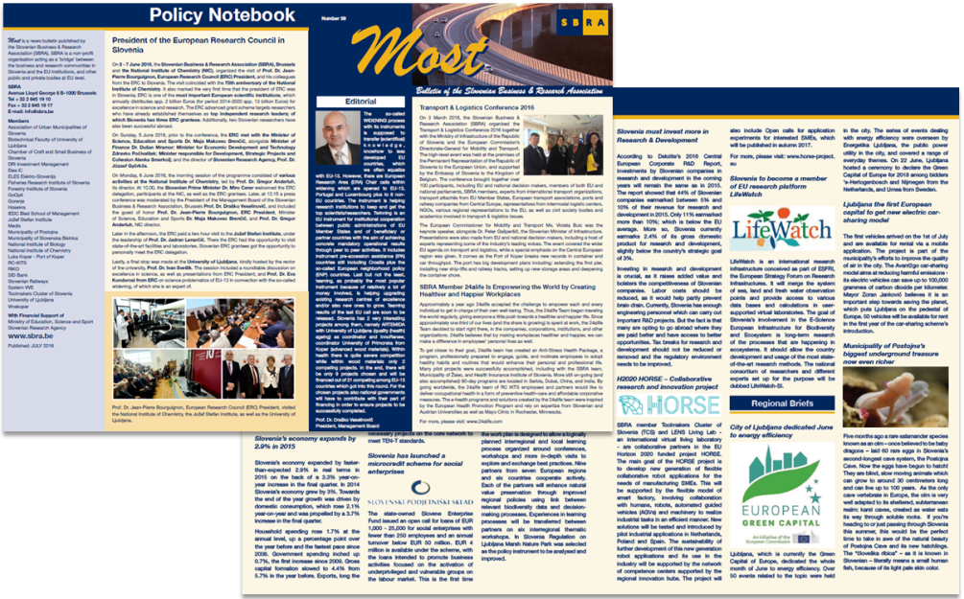
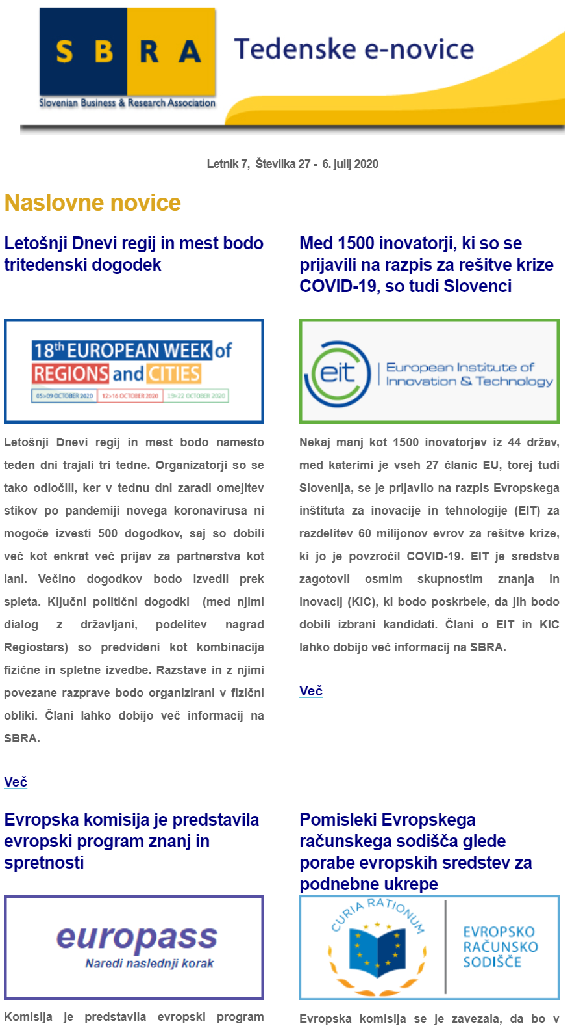
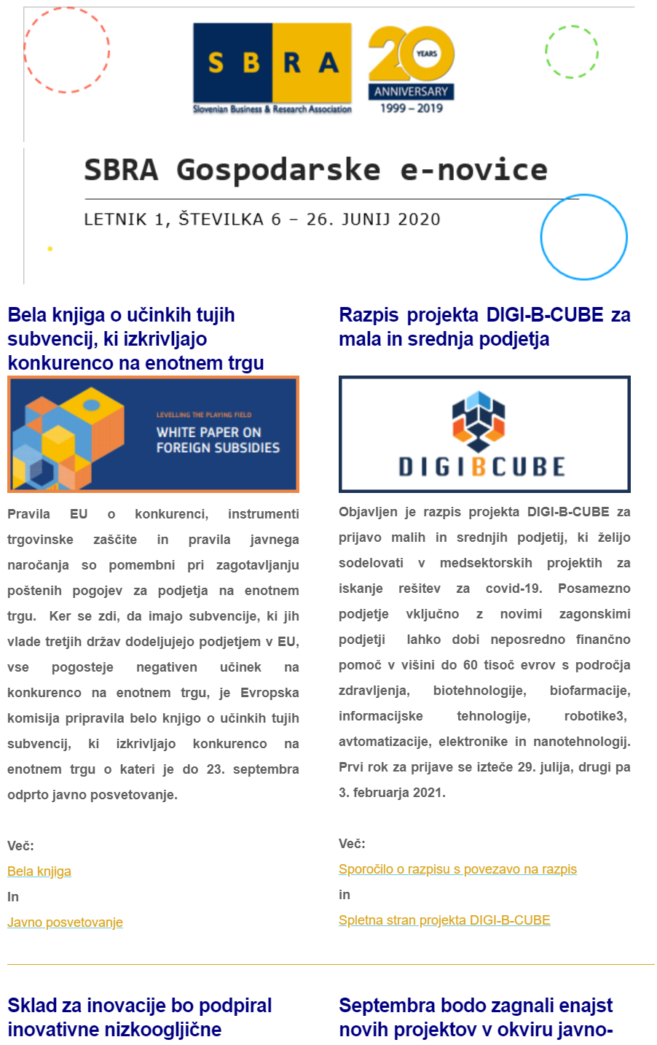
Core Activities
Informing members on economic developments, with a renewed focus on EU projects, programs and funds. A weekly scan of news, relevant calls, events, publications, etc. – disseminated via weekly e-news bulletin. Additional, bimonthly news bulletin regarding the economy.
Partner Search – besides informing members of relevant EU programs and projects, we actively strive to find and search for relevant partners and potential project consortia.
Training – preparing workshops and study trips for its members
Networking – Secretariat of Network of European Financial Institutions for Small and Medium Sized Enterprises (NEFI), membership in IGLO (Informal Group of RTD Liaison Offices), ERRIN (European Regions Research and Innovation Network), UnILiON (Universities Informal Liaison Offices Network), Vanguard initiative (regional network for promoting regional innovation ecosystems) and ENDR (Network of Defence Related Regions).
Promotional events, publishing reports and organizing conferences. Publication MOST allows us to disseminate our members’ achievements widely.

Slide 18
Why is it important to be present in Brussels
70% of all national legislation is decided in Brussels
Horizon Europe is centralised funding worth 95,5 bn EUR for the period 2021-2027
More than 3000 representation offices in Brussels
Getting the EU funding for R&I activities is a gradual process that requires:
Early access to working programmes and information on calls for proposals
Constant communication with EU institutions
Regular promotion of R&I activities on the EU level
Networking and matchmaking activities for building project proposals
Membership and constant presence in different R&I partnerships that co-decide EU funding programmes and research policies
Personal contacts and cooperation with other representatives
Special mission purposes towards EU institutions

Slide 19
HORIZON EUROPE IN NUMBERS !!!
European Parliament did a lot for HE figures!
Initially in 2018, the European Commission had proposed a budget of €100 billion, the European Parliament however requested that the amount should be increased to €120 billion, this proposal was later reduced to €94.4 billion.
In July 2020, EU leaders agreed to spend €80.9 billion (in 2018 prices) on Horizon Europe over the next seven years, of which €5 billion would be coming from the EU Recovery Plan, to be spent until 2023 on top of the rest of Horizon Europe.
The €5 billion from the recovery fund is intended to help EU tackle the pandemic and recover from the economic crisis. Significant parts of Horizon Europe, such as the European Research Council (ERC) and Marie Skłodowska Curie Actions (MSCA) will not get money from this source.
On 13 October 2020, MEPs in the budget negotiation team sent a new proposal to the Council of the EU advocating for a €39 billion increase for 15 flagship programmes – including Horizon Europe – in the long-term EU budget. They want budget ceilings raised by €9 billion and asked for an estimated €13 billion in financing costs of the pandemic recovery fund to be counted above the long-term budget. MEPs also want unused recovery funds to be reallocated to the InvestEU programme, and a mid-term adjustment for cohesion programmes focused on a “just transition” to a carbon-free economy.

Slide 20
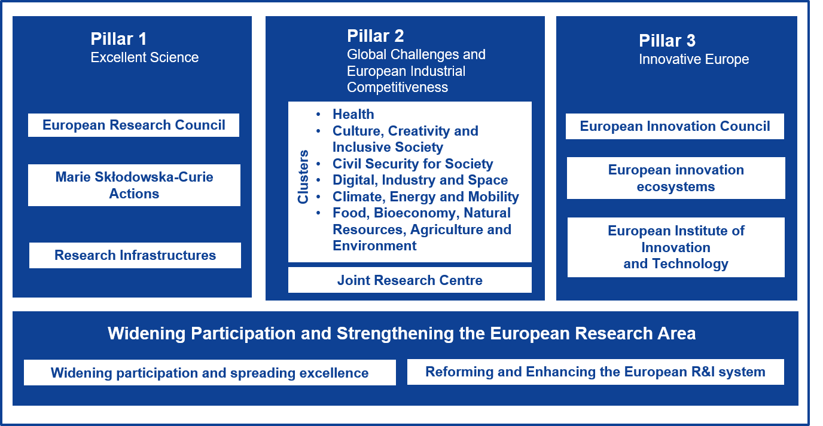
Structure of the Horizon Europe

Slide 21





Adaptation to climate change, including societal transformation
Healthy oceans, seas, coastal and inland waters
5 mission areas
+ Bauhaus
Cancer
Climate-neutral and smart cities
Soil health and food

Slide 22

Thank you!
Slovenian Business & Research Association
Rue Belliard 40
1040, Brussels, Belgium
tel: +32 496 556131, +386 41651004
drasko.veselinovic@sbra.be
www.sbra.be

